Slide 1
First Experiences with Cryring@ESR Commissioning – What went well, what could be improved.
S. Fedotova,
Z. Andelkovic, W. Geithner, F. Herfurth, M. Lestinsky, G. Vorobyev

Slide 2
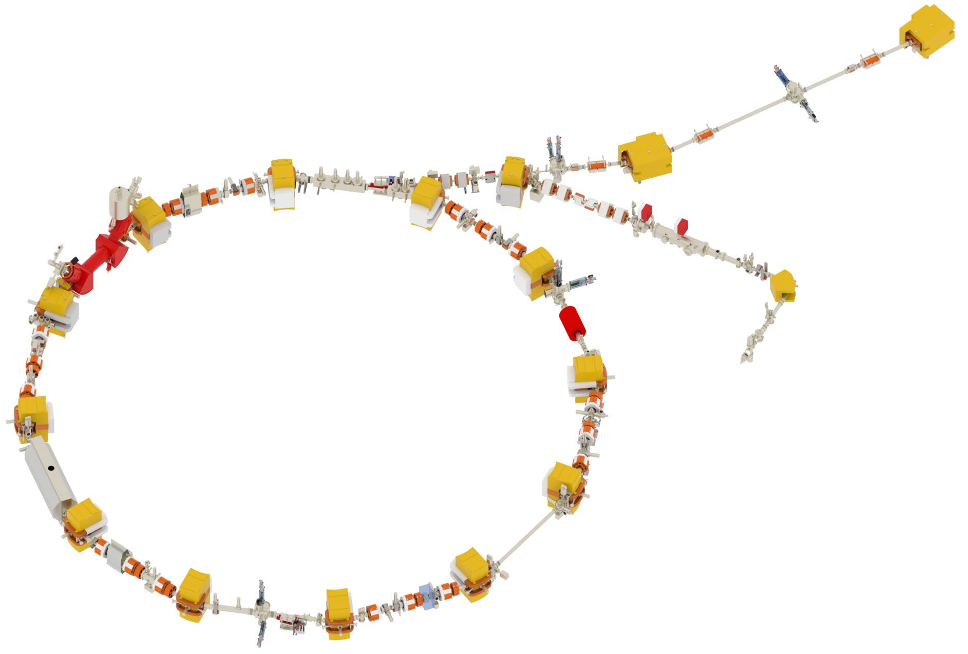
CRYRING@ESR commissioning
Injection septum&bumper
RFQ
300 keV/nucleon
Main objective-
„First turn“
Ion source
H2+
October 18th – November 18th, 2016

Slide 3
CRYRING@ESR commissioning
First-turn systems to be controlled/monitored
HV power supplies
ion source
electrostatic optics
inj. bumper&septum
RF-cavity
RFQ
Magnets´ power supplies
Diagnostics
dipoles
quadrupoles
steerers
inj. septum
Screens
Faraday cups
BPMs
Phase probes
Schottky
excl. el.cooler
sextupoles

Slide 4
Control system used for the first turn
CRYRING
machine experts
Java Apps
LSA
Servers
Middleware
Settings Mng
FESA
explorer
Devices
FESA, C++
Timing
system

Slide 5
Results
YRT1DF7
Inj.bumper
BPMs
1st pass
! First Turn !
YR11DF
injected beam shape

Slide 6
What went well during the beam time
Reached main objective, learned, gained experience.
Quick support from expert groups.
Diagnostics applications: CUPID, Cry-Cup, CRY-Phase-probe.
Control system changes on the fly:
Diagnostics (LOBI)
Controls (CSCO)
System design (PBSP)
Power supplies (LOEP)
improving of GUIs appearance and functionality
setting up of local workspaces
developing of a handy script for saved data
fixing FESA classes

Slide 7
What would allow us to be more efficient
Pulsed operations.
Spare electrodes insert.
Permanent status monitoring.
Ion source uptime:
ParamModi easy to use:
Scan application:
Transparent and flexible timing:
Monitoring of devices.
Stepwise values input.
Go back to a previous value.
Scanning physics parameters.
Easy properties configuration.
Saving of scan templates.
Flexible settings.
Application showing timing model and events.

Slide 8
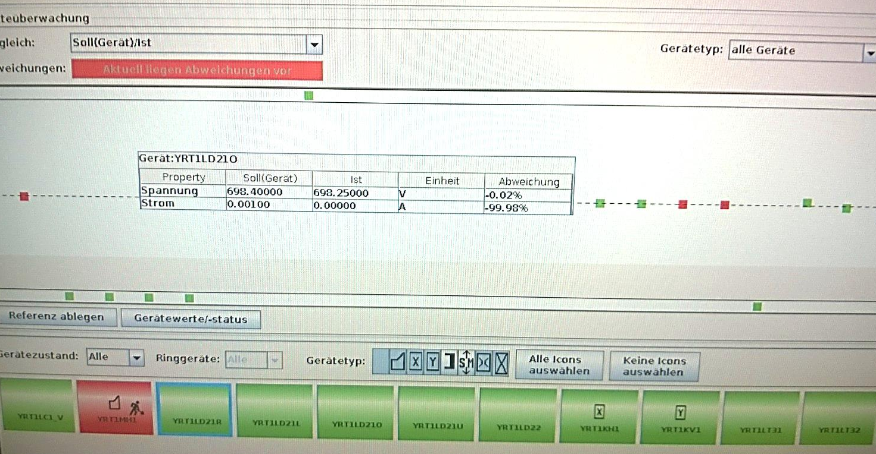
ParamModi and Scan application

Slide 9
Flexible and transparent timing
HW
Application for timing:
settings and monitoring.
1st Turn
injected beam shape

Slide 10
Future CRYRING@ESR Milestones
Bakeout system
test
E-cooler test
CRYRING@ESR:
stored ions
beam cooling
Test of first experiment
Ready for ESR beam
2018
May ´17
end ´17
Mar ´17
Jan ´17

Slide 11
CRYRING@ESR says: Thank you!
Facility
Engineering
Assembly
Ring RF
Controls
GSI/FAIR Expert Groups
UNILAC RF
Beam Diagnostics
Power Supplies.
Mechanical Design/Integration
Vacuum
Magnets

