Slide 1
„hands-on“ UNILAC Operator Training 2016
Stephan Reimann, Mariusz Sapinski

Slide 2
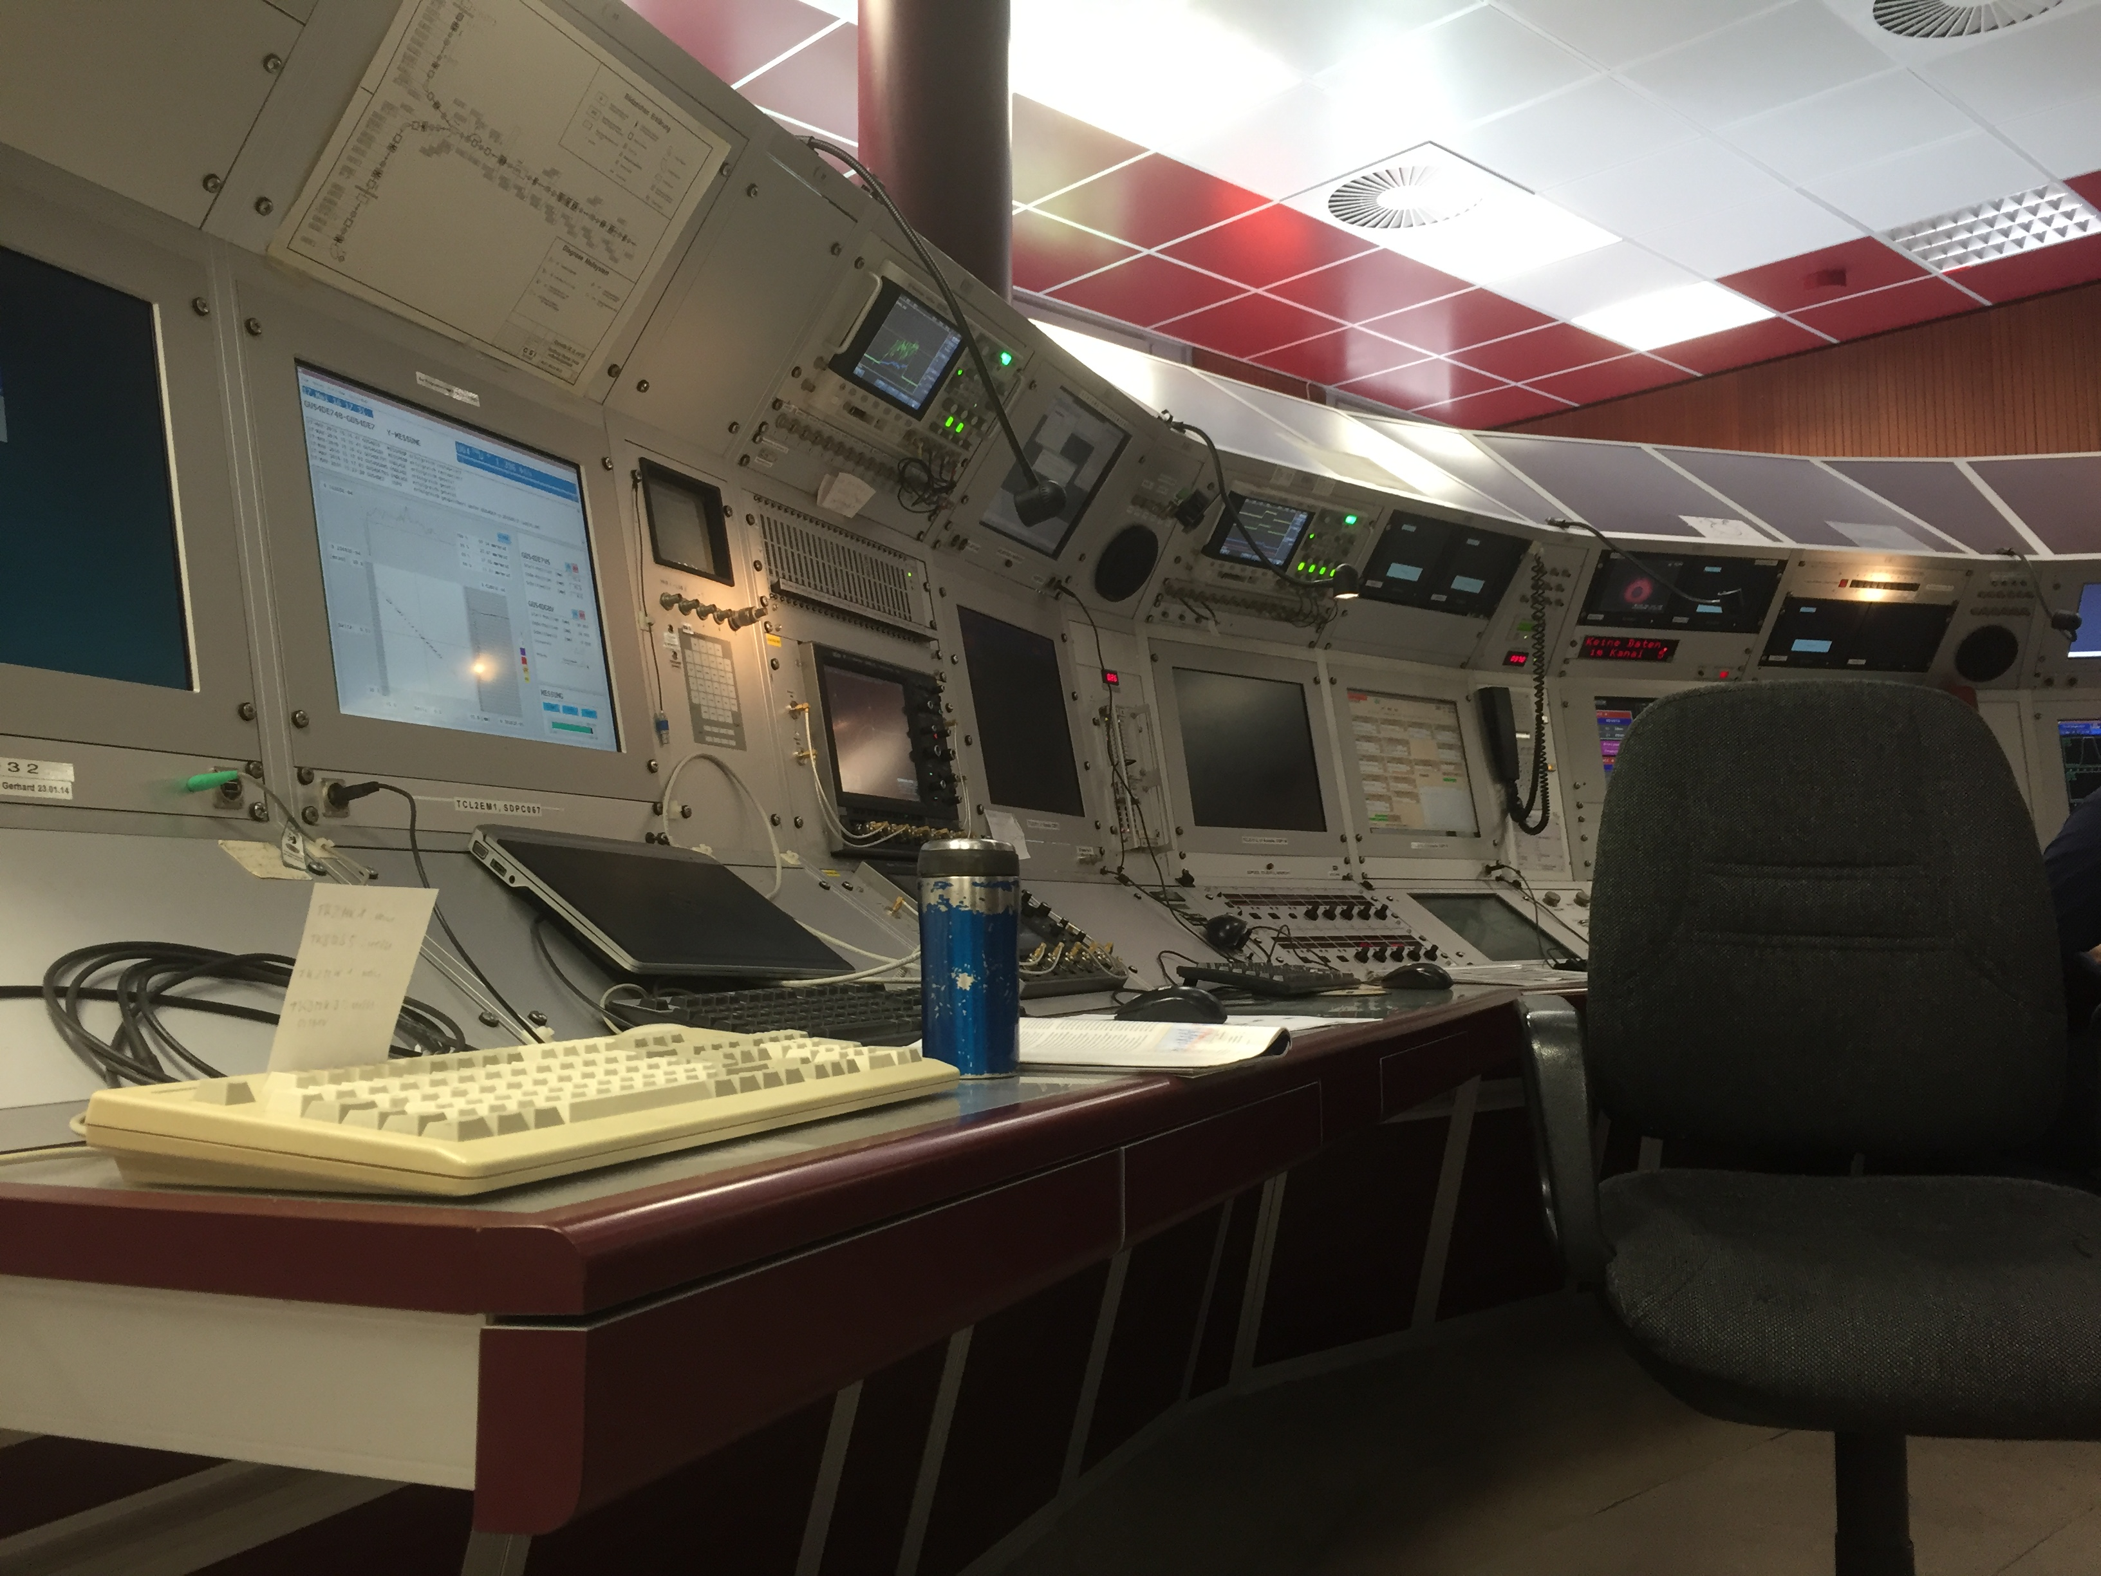
Outline
reasons
preparation
concept
results
lessons learned

Slide 3
reasons/ goals
last beam time till 2018
why now?
operations act → obligatory periodical operator training (last training shifts in 2012)
operator theory workshop in January → practical part
2 new department members and 2 persons came back from parental leave (>1,5 years without operation)
inhomogeneous knowledge distribution in shift crew
last chance for a long time to extract the information, how we operate the UNILAC → create some guides for future operator training
(one has to make a start)

Slide 4
Preparation
we applied for 9 shifts for operator training exclusive
but there was no preconception from former training shifts
what do the operators know?
where are the knowledge gaps?
what do experienced operators think is important?
do we need individual training concepts?
how many persons can be trained at the same time?
how long will it take
→ small working group (6 persons)

Slide 5
Conditions
9 exclusive shifts (22.04. – 24.04.)
UNILAC/ RF commissioning finished
2 Ion sources available (ECR with He, PIG with Ti)
2 Targets (M-branch and Z6)
→ 2 teams possible (1HSI, 1HLI)
→ one supervisor per shift (experienced shift leader)

Slide 6
Setup Guides
Separate UNILAC in 7 logical sections
preparation of 7 rough guides:
collect information and write short setup guides (done by experienced operators and shift leaders)
1 document per section (1-5 sides)
Result: mixed quality, but very good for a rough document

Slide 7
what else
all operators were asked for their individual preferences
result: a very small list
most asked was the complete setup from source to target
shift leaders usually don't meet on shift, so they all have their own ways of thinking the machine
so we decided to bring them together for discussing „hands-on“
for limiting these discussions → decision for clear „roles“
supervisor, documentation, trainees
we had 2 free training slots for interested „guests“ from CSCO and PBSP

Slide 8
The Concept
shift composition
in each shift are 5 operators in 3 different roles
1 experienced supervisor
at least 1 responsible for documentation
2-4 Trainees
some trainees got 2 or 3 shifts in a row
content/ schedule
in principle trainees should try to setup the machine alone, using the guides
all sections: PIG, HSI - Stripper, HLI - UN7DC2, Alvarez, ERs, M3, X6
individual preferences were included into the training schedule
the supervisor guides and helps the trainees if needed and assure the link to the theory talks from the workshop
goal of the last 2 shifts was the beam setup for the experiments
documentation
the experienced operators discuss their „way of operation“ and correct/extend the prepared guides
they add pictures and explanations
the trainees check permanently, whether the guides are understandable and usable

Slide 9
Trainings Schedule

Slide 10
Experience/ Results
conclusion: excellent training, average documentation
after a very short storming phase, the first shift performed well and worked very concentrated
even the night shift performed well (at least till 4am ☺)
feedback was consistently positive, all operators seem to be satisfied
Side-effect: experiments on Monday after the training shifts could start on time with perfectly adjusted beams
main question: WHY NOT EARLYER
suggested improvements
not more than 2 trainees on shift
(it seems that we have some very talented „teachers“ in our shift crew)

Slide 11
TODO
check the guides and notes and bring all together
improve the guides und check with UNILAC experts
→ after the beam time
the same was planed for SIS18 operation in May
TK-setting + SIS injection (C.K.Wetzel, Y.El Hayek)
BI Guidelines from the Workshop (C.K.Wetzel )
fast and slow extraction, ...
→ but the SIS18 commissioning is late this year ...

Slide 12
lessons learned 4 FAIR?
thus we have no experienced fair operators, the concept is not one-by-one copyable for FAIR accelerators
but:
shift leaders should take a strong part in commissioning of all new machines
then they can start writing the corresponding guides and adjust it with experts knowledge
so they should be able to train new operators in a similar way
→ Discussion

Slide 13
Thanks

