Slide 1
Correcting the beam optics: Orbit Response Matrix analysis for the FAIR storage rings
Oleksandr Kovalenko

Slide 2
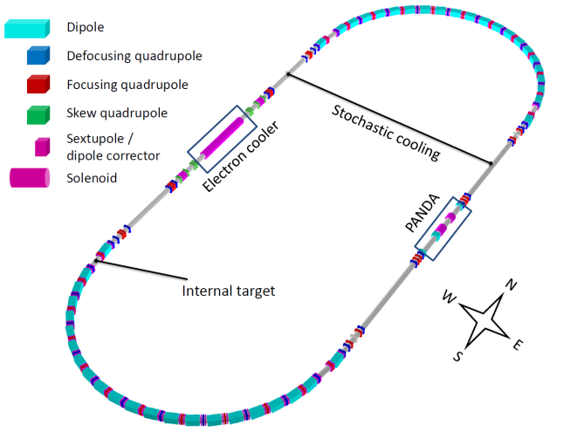
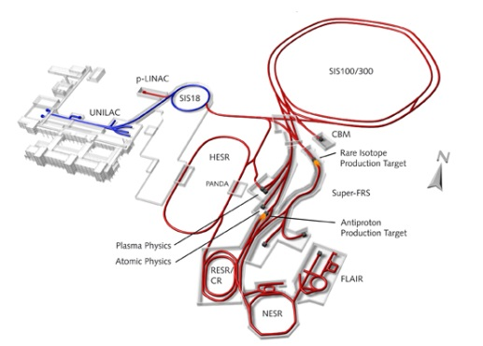
Introduction
What is Orbit Response Matrix (ORM) analysis
Why do we need it
How was it implemented
Application for FAIR storage rings.
Results and observations

Slide 3
Why we need ORM analysis
Real magnetic lattice has errors in comparison to the model:
Magnet rolls
Magnet misalignments
Wrong quadrupole settings
Calibration errors in dipole correctors and Beam Position Monitors
When not corrected it causes:
Breaking the lattice periodicity
Increasing the harmful effects of the nonlinear resonances
Reducing the beam lifetime
ORM analysis: search for the errors locations and values. Restore the optics.
Model Lattice
+
Errors
=
Real lattice
ORM
Model Lattice without errors!

Slide 4
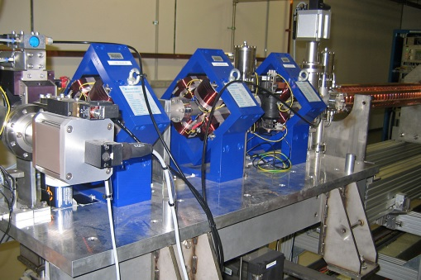
ORM analysis. Response
Knee
Tiny hammer tap
Leg extension
Signal
Reaction
System
Internal data
Neuron pathway
Lattice
Dipole correctors kicks
Beam offset at BPMs
Machine parameters

Slide 5
Orbit Response Matrix
BPMs
Response matrix R
Correctors
$$\left(\begin{matrix}x \\ y\end{matrix}\right)=R\text{×}\left(\begin{matrix}θ_{x} \\ θ_{y}\end{matrix}\right)$$
=
×
Minimize the difference between observed and model response matrices
Obtain the errors of the machine parameters
Coupling
Horizontal plane
Vertical plane
Observed (real) response matrix: $R_{ij}^{yy}=\frac{y_{i}}{θ_{y, j}}$ (vertical plane)
Model (theoretical): $R_{ij}=\frac{\sqrt{β_{i}β_{j}}}{2sin \text{π}Q}sin \text{(2}\text{π}\text{|}{\text{φ}}_{i}−{\text{φ}}_{j}\text{| – }\text{π}Q\text{)}$
$β$ – beta-function, $\text{φ}$ – betatron phase, $Q$ – betatron tune

Slide 6
Tools
CERN MAD-X accelerator code
Twiss parameters computation
Beam orbit computation
Nonlinear beam dynamics
Python programming language + PyQt + linear algebra libraries
General algorithm
Testing
Graphical User Interface
Lattice parser
Plotting
Singular Value Decomposition

Slide 7
Iteration process
$V$– quadrupole gradients vector.
$R=f\left(V\right)$ – orbit response vector
$R\left(V\right)≈R\left(V_{0}\right)+R^{′}\left(V_{0}\right)\left(V−V_{0}\right)$
$R^{′}\left(V_{0}\right)=J=\left[\begin{matrix}\frac{∂R_{1}}{∂V_{1}} & ⋯ & \frac{∂R_{1}}{∂V_{k}} \\ ⋮ & ⋱ & ⋮ \\ \frac{∂R_{mn}}{∂V_{1}} & ⋯ & \frac{∂R_{mn}}{∂V_{k}}\end{matrix}\right]$
${V=V}_{0}+J^{−1}×[R(V)−R(V_{0})]$
χ²_{red} – estimation of fit quality
V₀
MADX
R(V₀)
MADX+Python
R(V)
Machine (only once)
J
Python
J⁻¹
Python
V
Python
Cycle
$V_{0}$ – first guess for the gradients is known from design
$R\left(V_{0}\right)$ – model response vector computed with MADX
$R\left(V\right)$ – observed response vector found by varying correctors
$J$ – Jacobian computed by varying gradients
$J^{−1}$ – pseudoinverse Jacobian calculated via SVD
$V$ – new quadrupole gradients
$V_{0}=V$. Back to the first step
ORM analysis

Slide 8
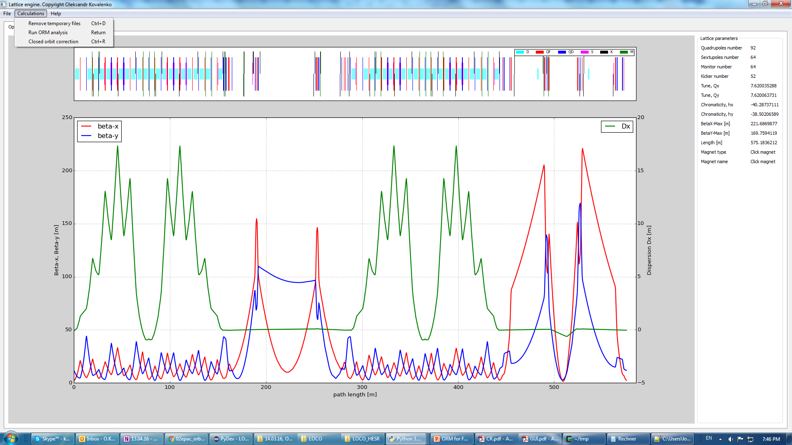
Program
Lattice statistics
BPM readout errors on/off
Coupling on/off
Search for the nonlinear errors (e.g. in sextupole gradients).

Slide 9
Results

Slide 10
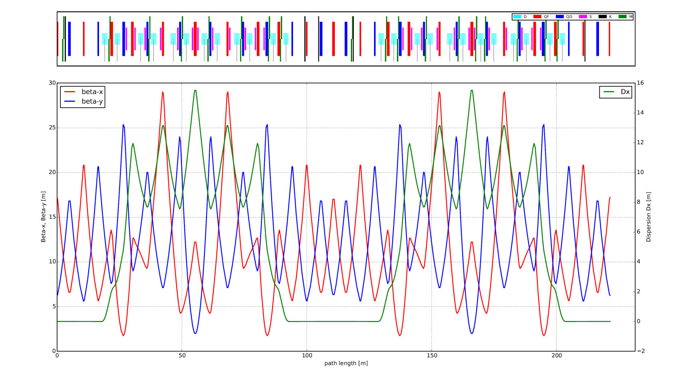
CR storage ring
Machine lattice
Optical functions
Lattice
Length | 221 m
BPMs | 18
Correctors, hor/ver | 29/21
Quadrupole families | 11

Slide 11
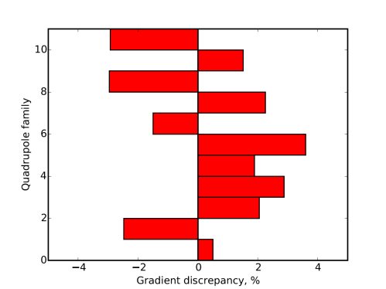
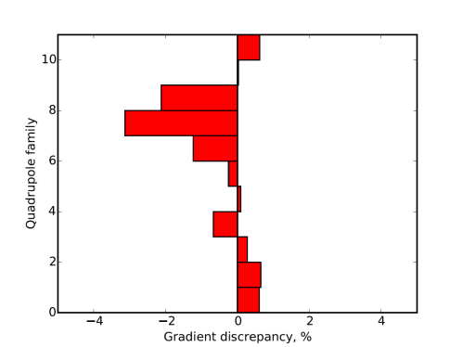
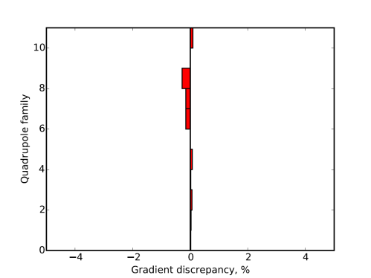
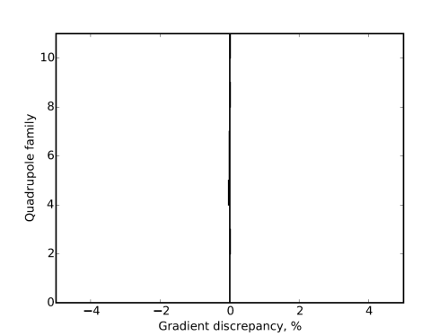
Orbit Response Matrix minimization in the CR
10 dipole correctors
±5% uniform quadrupole gradient errors
Perfect BPMs
1
2
3
4
ORM discrepancy
4 iterations. Errors found. Optics restored.
Gradient discrepancy

Slide 12
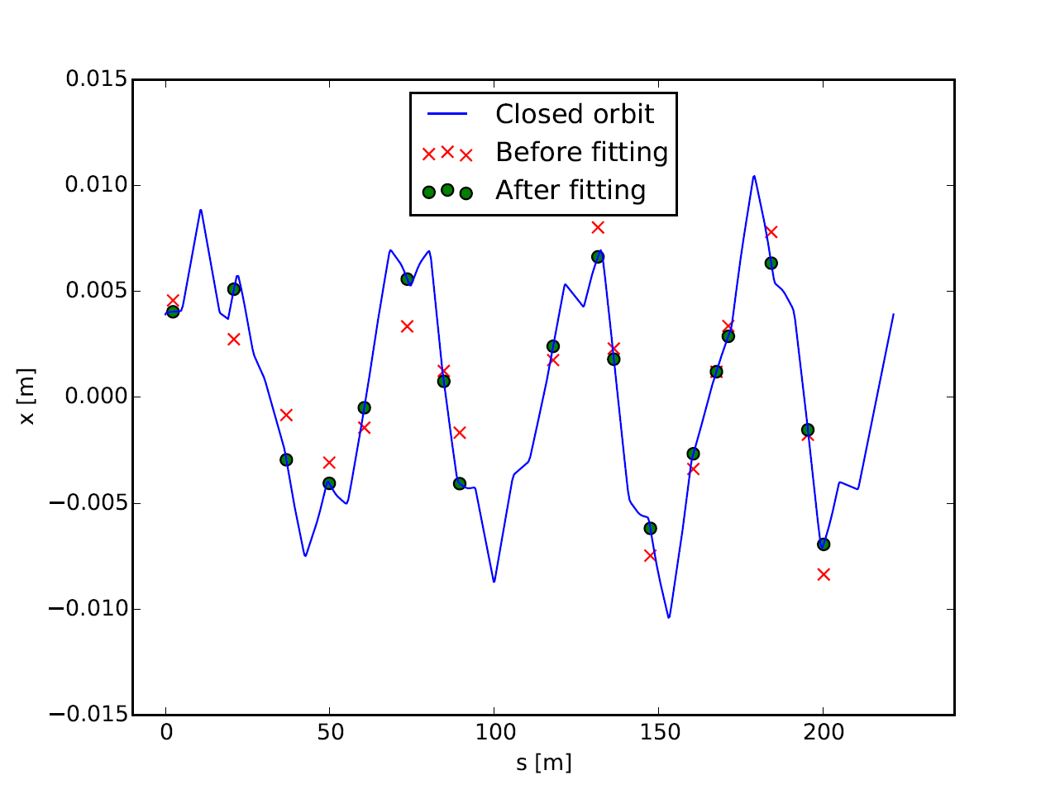
ORM analysis. Orbit fit. CR
Orbit shift excited by one corrector
50 dipole correctors. Random quadrupole gradient errors in the range ±5%.
The distortion of the orbit before the fit is up to 3 mm.
Three iterations, about one minute of computation time
All the errors of the quadrupole gradients were found almost exactly!
The rms difference between the model and the measured orbit (green cirlces) after the fit is less than 1 μm.

Slide 13
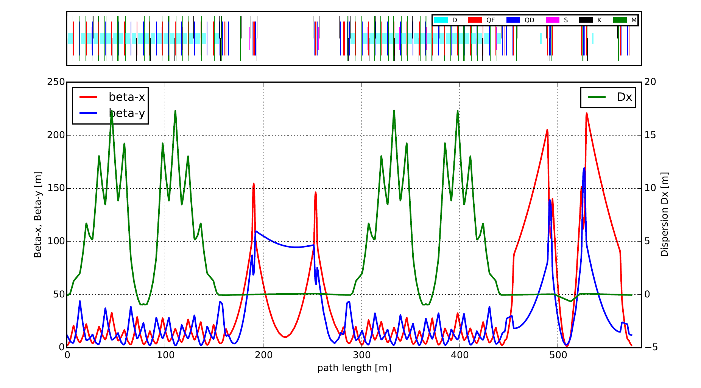
HESR storage ring
Machine lattice
Lattice
Length | 575 m
BPMs | 64
Correctors, hor/ver | 26/26
Quadrupole families | 12
Optical functions

Slide 14
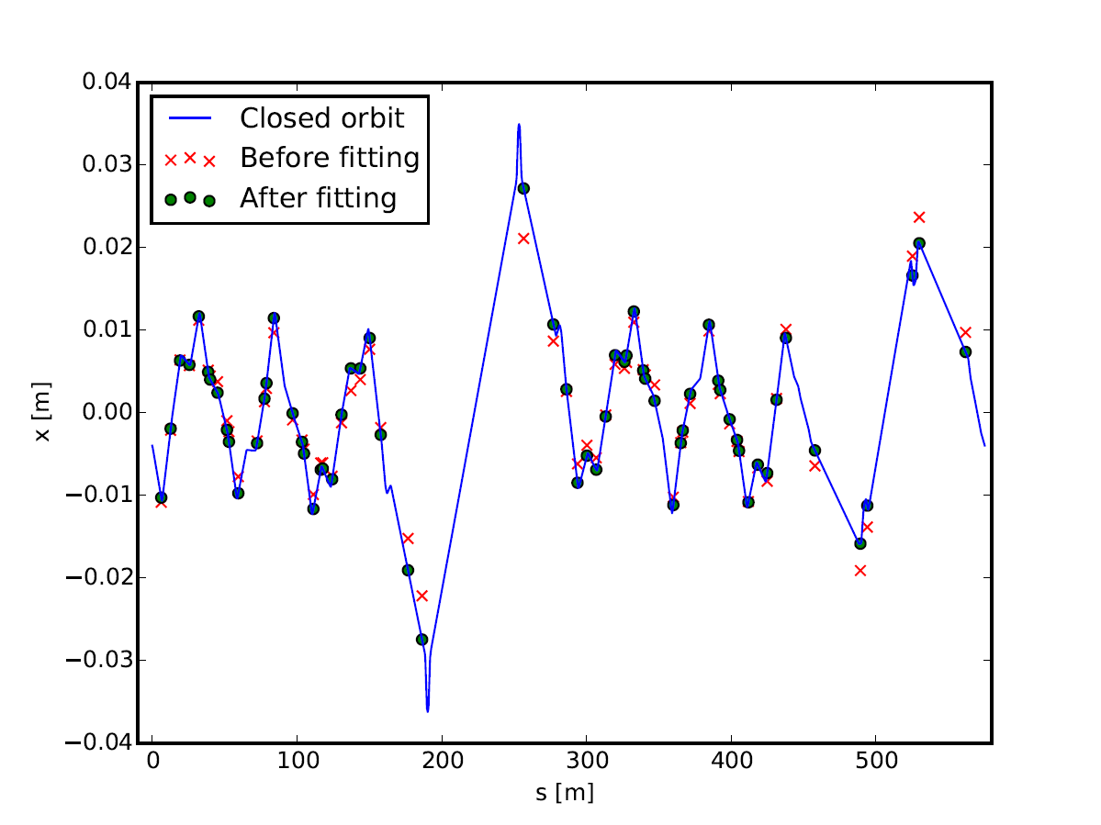
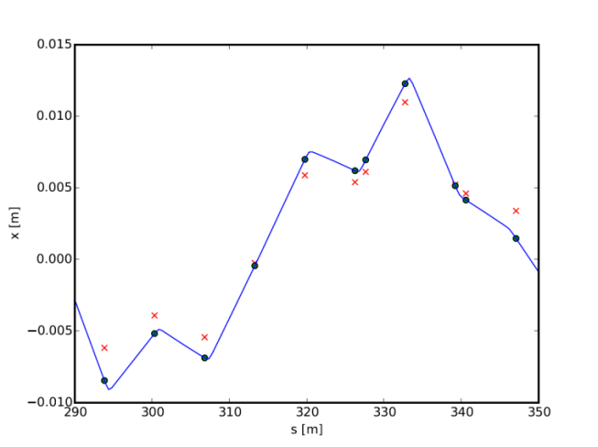
Fitting the orbit. HESR
Distortion of the orbit before: up to 10 mm
After the 4 iterations of ORM analysis: < 0.2 μm rms distortion

Slide 15
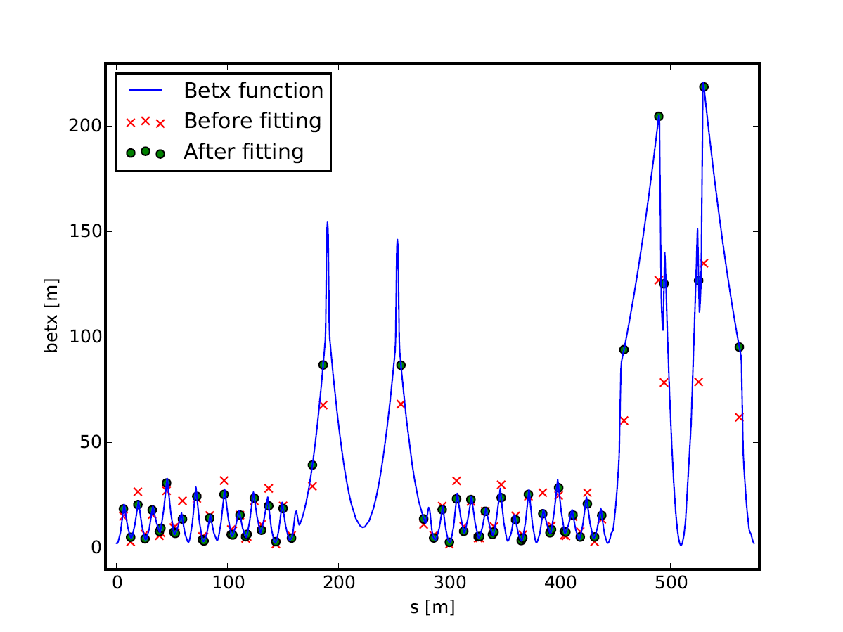
Beta function fit. HESR
Beta function: focusing, beam transverse size
Before fitting > 70% (in the target section) discrepancy between model and real beta function
After ORM fitting: < 0.03% rms deviation of beta-function

Slide 16
Observations
Sensitivity. BPM readout errors.
uniformly distributed BPM readout error in the range ±1 mm . After 3-4 iterations the ORM code converged with χ² = 0.99 for the CR and χ² = 0.97 for the HESR. The quadrupole gradients were found with an rms error ≈0.5% (BPM noise level).
Singal-to-noise ratio. Use the maximum possible corrector kicks.
CR: the orbit offsets at BPMs were limited by the maximum strength of the dipole correctors.
HESR: the limiting factor was the magnet aperture (full aperture in most of the magnets is only 89 mm)
This approach might however fail when there are strong nonlinearities in the BPMs leading to large readout errors for large orbits offsets (at the edges of BPMs).
Data for the response matrix. Use any type of data you can obtain.
Dispersion: varying frequency in the RF accelerating cavity, measure beam offsets.
Phase advances
Tunes etc.

Slide 17
Conclusions
Response matrix analysis is a powerful technique to track down the errors in the lattice.
Can be used during beam commissioning as well as during routine machine operation
Type of magnetic elements, the errors of which can be corrected:
normal and skew quadrupole gradients
calibration factors of BPMs and correctors
sextupole gradients
Successful proof of concept for CR and HESR FAIR storage rings. Faulty optics was completely restored.
Next steps
Applying the ORM analysis for SIS100
Test of the ORM analysis for the existing machines
CRYRING (GSI), COSY (FZ Jülich), CSR (Lanzhou)
ORM analysis into Java

