Slide 1
Beam Instrumentation
for FAIR – An Overview
Report to FC2WG – M. Schwickert
for the Beam Instrumentation Team

Slide 2
Outline
Mission of BI Department
and General Concepts
Infrastructure Systems and In-Kind Situation
Overview of diagnostic systems for FAIR,
Focus on HEBT and SIS100
  Beam Intensity (Details on Current Transformers, Particle Counters, related Aquisition Systems...)
  Beam Profile
  Position (incl. closed orbit feedback and tune measurement)
Summary
M. Schwickert | BI for FAIR | FC2WG-Meeting | 01 July 2015
<number>

Slide 3
The BI-Mission
Supply operations team with all necessary beam parameters for routine operation and first-level troubleshooting
  machine commissioning treated as separate project phase
  quite a few ‚expert systems‘, presently for specialists only....
New BI tasks / responsibilities at FAIR (taken from CSCO):
  Front-end controllers (FEC) for beam instrumentation
  related FEC software
  ALL BI-related electronics at beamlines
  fieldbus for diagnostics, i.e. PROFINET
Former BI tasks given to CSCO:
  interlock system
  stepper motor control
M. Schwickert | BI for FAIR | FC2WG-Meeting | 01 July 2015
<number>

Slide 4
General Concepts
application of industrial standards to maximum extent:
Mechanics: flanges, valves, connectors etc.
Electronics: form factors, bus systems, pinnings, network
facility-wide standardization, i.e.wherever possible:
common realizations of diagnostic devices for all machines!
→ reduces RnD work
→ improves maintainability (less administrative effort)
→ saves time + manpower (e.g. less training for service teams)
→ reduces spares inventory (ease of exchangeability)
where applicable, e.g. for actuators, electronic parts:
Use of commercially available products (COTS), with "second source"
comprehensive timing concept in collaboration with GSI controls and equipment groups
clear separation of 'Data Acquisition'-layer as common interface to control system → German In-Kind Contribution EoI 13i
full access to software source code (down to VHDL) is mandatory
use of open source/open hardware instead of proprietary software / operating systems
M. Schwickert | BI for FAIR | FC2WG-Meeting | 01 July 2015
<number>

Slide 5
LOBI – Organizational Chart
Department Head: M. Schwickert, Deputy: A. Reiter (48,3 FTE)
7 LOBI – Work Package Leader
SIS100
P. Kowina
CR
O. Chorniy
IPM
T. Giacomini
HEBT
B. Walasek-Höhne
SFRS
M. Schwickert
p-Target
A. Reiter
p-Linac
P. Forck
6 LOBI – Groups
MI
Mechanics &
Infrastructure
ED
Electronics
Development
DS
Data Acquisition &
Software
HI
HEBT Instruments
RI
Ring Instruments
RD
Research &
Development
8,7 FTE
11 FTE
6,2 FTE
4,2 FTE
7,2 FTE
9 FTE
Leader:
B. Walasek-Höhne
Dpty: C. Andre
P. Boutachkov
H. Graf
{A. LeFevre -> RBDL}
V. Lavrik*
Leader: R. Fischer
Dpty: C. Dorn
R. Boywitt
S. Fiedler
M. Glück
M. Hartung^{SP}
R. Mahr
S. Schuhmacher
K. Steiner^{SP}
J. Wohlers
Leader: H. Reeg
Dpty: W. Kaufmann^{SP}
R. Johänntges
C. Krüger
K. Lang
C. Müller
H. Rödl^{DO,SP}
C. Schmidt^{DO,SP}
J. Wiessmann^{DO,SP}
M. Witthaus
F. Kurian*
Leader: T. Hoffmann
Dpty: R. Haseitl
H. Bräuning
R. Lonsing^{SP}
P. Miedzik
T. Milosic
M. Beck⁺
Leader: P. Kowina
Dpty: T. Giacomini
P. Burkhard
O. Chorniy
M. Müller
C. Wetzel^{DO,SP}
T. Reichert*
J. Latzko⁺
Leader: P. Forck
Dpty: T. Sieber
R. Singh
S. Udrea^{EC}
M. Almalki*
S. Lederer*
A. Lieberwirth*
Y. Shutko*
B. Zwicker*
⁺student, *phd student, ^{DO} delegated operator, ^{SP} shift participant, ^{EC} external contract
M. Schwickert | BI for FAIR | FC2WG-Meeting | 01 July 2015
<number>

Slide 6
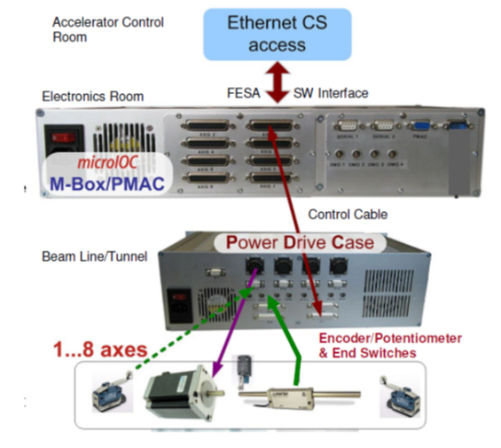
General Concepts Infrastructure I / II
In agreement with other equipment groups (CSCO, CSVS, LORF, LOEP etc.) clear decisions for:
  FESA as common software interface
  CENTOS7 as FEC operating system
  White Rabbit and BuTiS
  as timing sources
  PROFINET as common fieldbus
  Siemens PLC as standard
  supported form factors:
  VME, uTCA/xTCA, PCIe/IPC
  MBox (Cosylab) for
  stepper motor control
M. Schwickert | BI for FAIR | FC2WG-Meeting | 01 July 2015
<number>

Slide 7
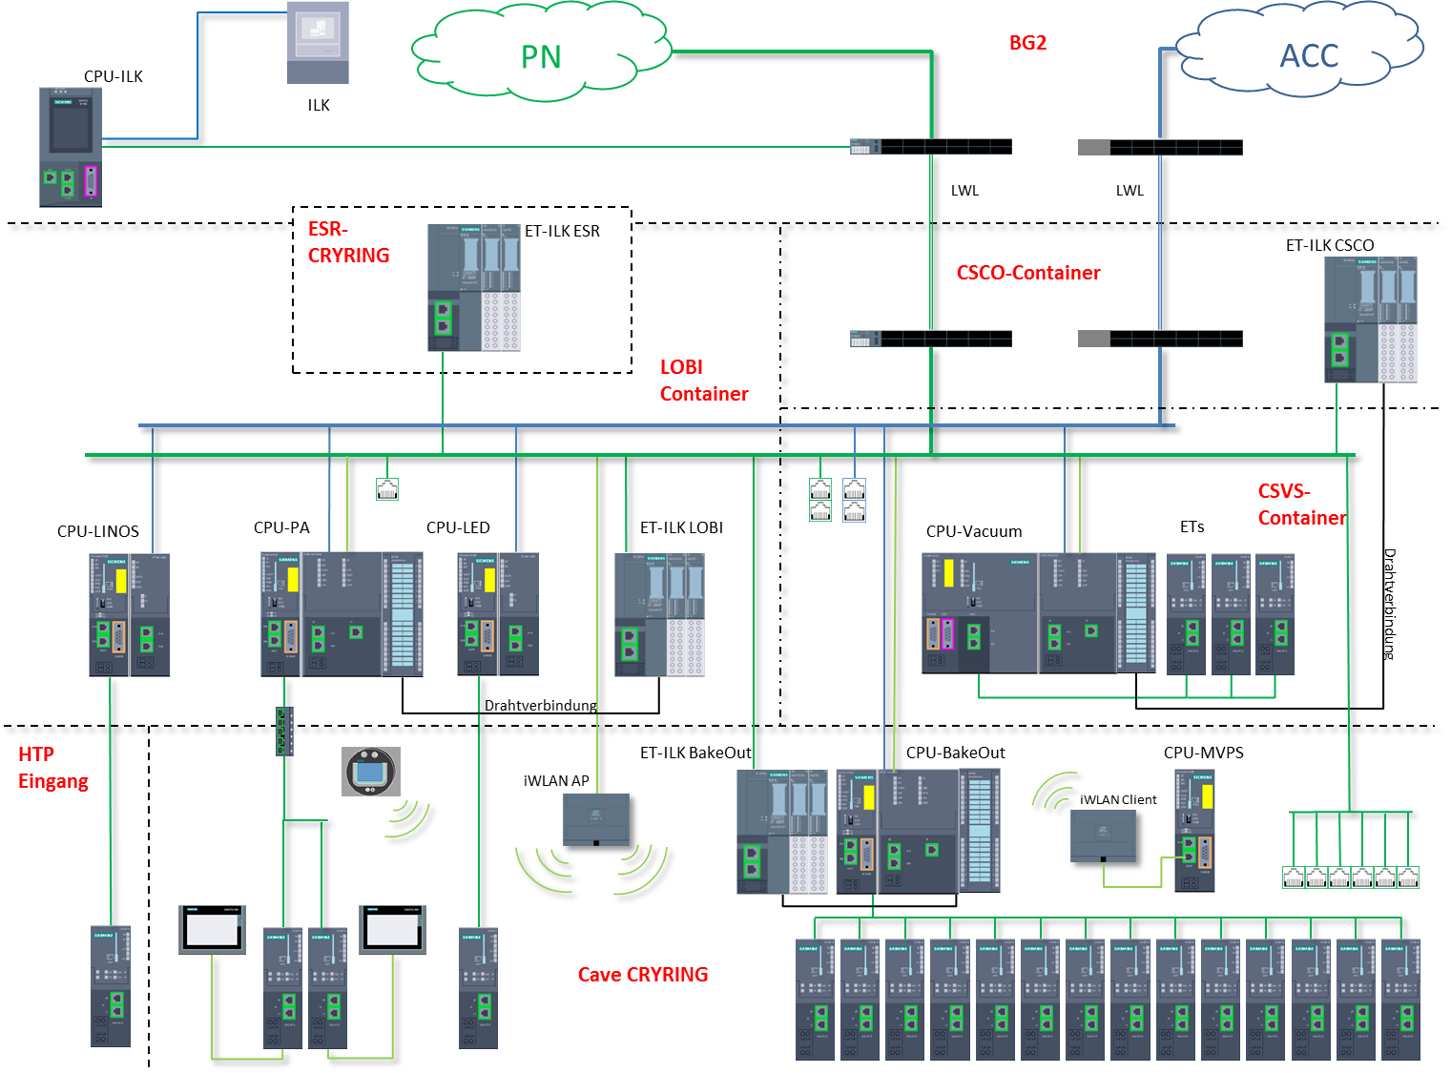
General Concepts Infrastructure II / II
PROFINET and PLC based devices
BI-Applications:
pressurized air control
iris control (BIF, CUPID)
gas flow control?
... more?
Applications integrated for CS:
vacuum control
bake-out
interlock
mobile vacuum pumping system
industrial WLAN
HMI / manual ctrl
Example: PROFINET layout for Cryring as testbed for FAIR
Courtesy of A. Petit
M. Schwickert | BI for FAIR | FC2WG-Meeting | 01 July 2015
<number>

Slide 8
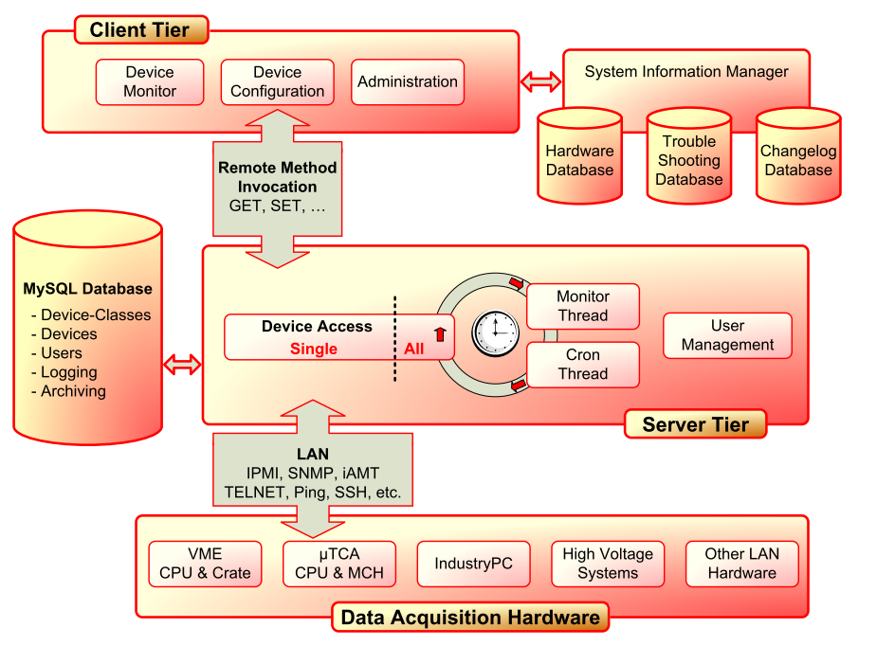
Infrastructure – Example: REMBRANDT
REMote Beam instRumentation And Network Diagnosis Tool
→ Java Framework to allow authorized user to monitor and control remote systems while hiding the underlying protocols, IP-addresses, user-ids, passwords etc.
Problem: In FAIR beam instrumentation devices and data acquisition components will be distributed over large area, partially inaccessible
Mandatory: control supporting LAN-based components like VME/µTCA crates, front-end controllers, middleware servers etc.
Many commercial systems provide remote control via various standardized protocols
REMBRANDT Software Architecture
REMBRANDT features:
Client-server architecture, fully implemented in Java
Application available for Linux/X-Term, MS Windows
REMBRANDT server monitors devices typ. every 10 seconds, logs changes, sends e-mail notifications...
Several user clients available: control and monitoring tool, system information management, database and user administration
REMBRANDT currently supports:
  SNMP, iAMT, IPMI, Ping, RDA
  direct device access via telnet, ssh or iAMT SOL
Courtesy of
T. Hoffmann
M. Schwickert | BI for FAIR | FC2WG-Meeting | 01 July 2015
<number>

Slide 9
FAIR-BI: In-kind-Partner, we‘re not alone...
In-Kinds by Slovenia (~9.5 M€)
GSI In-Kinds (~20 M€)
Work Package | Content | FAIR Section
D1 | BPM pre-amplifiers | SIS100, HEBT, HESR
D2 | BPM Data Acquisition (circular machines) | SIS100, CR, HESR
D3 | Closed Orbit Feedback System | SIS100
D4 | BPM Data Acquisition (Single Pass) | p-Linac, HEBT
D5 | Pressurized Air Drives and Control | SIS100, HEBT, CR, p-Linac
D6 | Low-Level RF (responsible: GSI-RF Team) | p-Linac
D7 | Beam-Loss Monitor (without Detector) | SIS100, HEBT, CR, HESR
D8 | Transformer Data Acquisition | SIS100, HEBT, CR, HESR
Data Acquisition for all machines:
HEBT PSP: 2.3.6.x.y.6
S-FRS PSP: 2.4.6.3.1
CR PSP: 2.5.6.x.y.6
SIS100 PSP: 2.8.6.x.y.6
pBar-Target PSP: 2.9.6.x.y.6
SIS100: Beam Position Monitors (PSP 2.8.6.2)
p-Linac: All diagnostic components except for french and slovene contributions
p-Bar Target (PSP 2.9.6): all diagnostic components
All Cryogenic Current Comparators HEBT PSP: 2.3.6.2 CR PSP: 2.5.6.1.3
All Residual Gas Profile Monitors
CR PSP: 2.5.6.4 SIS100 PSP: 2.8.6.4
Multiwire-Proportional Chambers (MWPC), Particle Detector Combinations (PDC) of HEBT (MWPC PSP: 2.3.6.5.3 PDC PSP: 2.3.6.3)
In-Kinds by India (~0,9 M€)
HEBT Diagnostic Vacuum Chambers
(psp-codes 2.3.6.3.1.2, 2.3.6.5.1.2, 2.3.6.5.2.2, 2.3.6.5.3.2)
In-Kinds by Russia
CR | ITEP
2.5.6.3.1 | Tune / BTF Exciter
2.5.6.3.2 | Schottky Pick Up
SIS100
2.8.6.3.1 | Tune / BTF Exciter
2.8.6.3.2 | Schottky Pick Up
+ CR Diagnostics by BINP
(various components)
In-Kinds by France (~0.5 M€)
p-Linac: Parts of LEBT diagnostics
p-Linac BPMs (Pick-ups, psp-code 2.7.6.5.1)
M. Schwickert | BI for FAIR | FC2WG-Meeting | 01 July 2015
<number>

Slide 10
Overview SIS100 and HEBT
M. Schwickert | BI for FAIR | FC2WG-Meeting | 01 July 2015
<number>

Slide 11
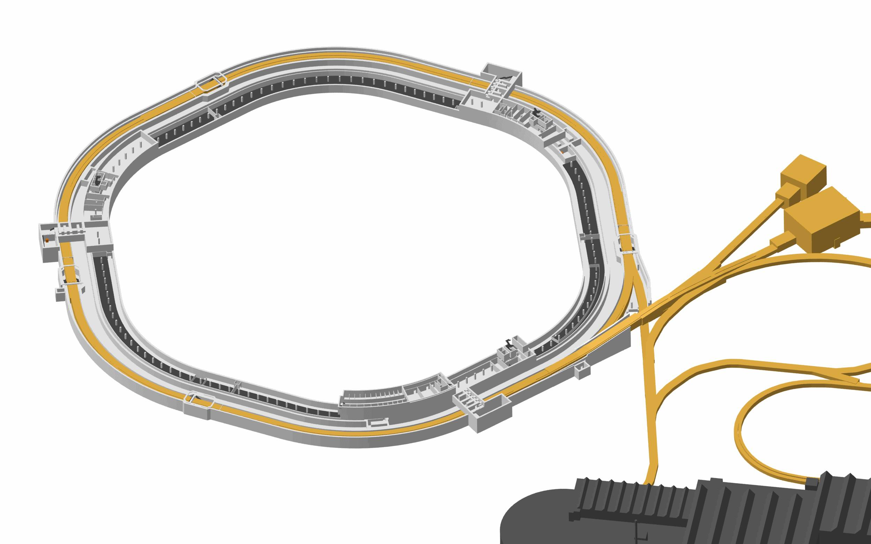
SIS100 - Challenges
Challenges for the Design of Beam Instrumentation:
wide range of beam intensities
(up to 5·10¹¹ U²⁸⁺/pulse,
10¹³ protons/pulse)
short (30-100 ns) and long (8 µs) pulse length
space charge effects
RF 'gymnastics' (barrier bucket system, bunch compression system)
XHV conditions, installation of BPMs in cryostats
M. Schwickert | BI for FAIR | FC2WG-Meeting | 01 July 2015
<number>

Slide 12
SIS100 Diagnostic Instruments
Diagnostic Device | Quan-tity | Insertion length [mm] | Measured Parameter | Application
DC Transformer | 1 | 600 | DC current | Stored current, beam lifetime
Novel DC Transformer | 1 | 600 | DC current | Stored current, beam lifetime
Fast Current Transformer #1 | 1 | (common with DCT) | Pulse-current | Injection efficiency
Cryogenic BPM | 83 | 400 | Beam centre-of-mass | Closed orbit, turn-by-turn variations, lattice functions, closed orbit feedback
BTF exciter | 1 | 1800 | Beam centre-of-mass after excitation | Tune by BTF, tune by noise excitation, PPL tune tracking, tune by Q-kick
Schottky pickup | 1 | 1600 | Momentum distribution, transverse Schottky | Δp/p determination, tune, chromaticity
Fast Current Transformer #2 | 1 | 450 | Broadband bunch structure | Longitudinal emittance
Ionization Profile Monitor | 1 | 2500 | Beam profile | Transverse emittance, injection matching
Beam Loss Monitor | 200 | x | Beam loss | Mis-steering of magnets, Halo detection at scraper, Vacuum induced loss
Scintillation Screen | 2 | 350 | Beam profile | First turn diagnostics
SEM-Grid | 6 | 450 | Beam profile | First turn diagnostics
Beam Stopper | 6 | 350 | Relat. Current | First turn diagnostics
Q-BPM | 1 | 950 | Quadrupol oscillations | injection matching, determination of incoherent tune spread
M. Schwickert | BI for FAIR | FC2WG-Meeting | 01 July 2015
<number>

Slide 13
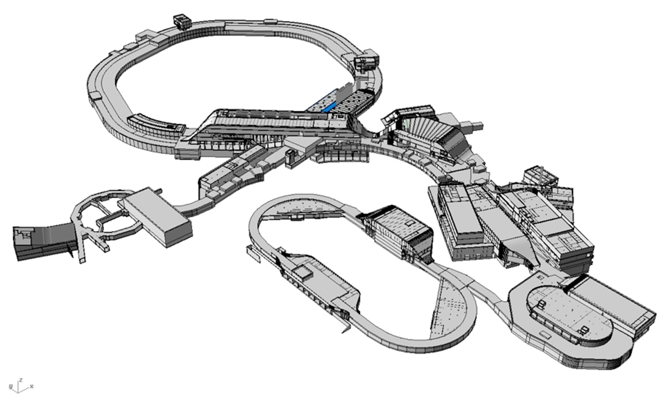
FAIR-High Energy Beam Transport (HEBT)
General requirements for beam diagnostic devices to measure....
... both, low and high beam intensities
... both, slow and fast extracted beams
Courtesy of
F. Hagenbuck
M. Schwickert | BI for FAIR | FC2WG-Meeting | 01 July 2015
<number>

Slide 14
HEBT Diagnostic Instruments
Diagnostic Device | Quantity (MSV) | Extraction Type | Measured Parameter | Remark
Resonant Transformer | 24 | Fast | Beam current
Fast Current Transformer | 11 | Fast | Bunch charge / time structure
Particle Detector Combination | 16 | Slow | Particle number | Measurement of low intensities
Cryogenic Current Comparator | 4 | Slow | Beam current | Measurement of high intensities
Beam Position Monitor | 38 | Fast | Centre-of-mass
SEM-Grid | 49 | Fast | Transverse profile | Profile & position
Scintillating Screen | 16 | Fast&Slow | Transverse profile | Profile & position
Multi-Wire Proportional Chamber | 34 | Slow | Transverse profile | Profile & position
Beam Ind. Fluoresc. / Ionization Profile Monitor | 15 | Fast&Slow | Transverse profile | Profile & position, high intensities
Beam Loss Monitor | 30 | Fast&Slow | Beam loss
M. Schwickert | BI for FAIR | FC2WG-Meeting | 01 July 2015
<number>

Slide 15
Common Acquisition Systems for FAIR
Acquisition System | Measured Parameter | Machines | Detectors
LASSIE | Beam Intensity, Loss, any time dependent signal | SIS18, HEST, SIS100, HEBT, p-Bar Separator, S-FRS, CR, HESR | Scintillator, Ionization Chamber, Secondary Electron Monitor, I/F-, U/F-device
CUPID | Beam Profile | SIS18, HEST, SIS100, HEBT, p-Bar Separator, S-FRS, CR, HESR | Scintillating Screen
POLAND | Beam Profile | SIS100, HEBT, p-Bar Separator, S-FRS, CR, HESR | SEM-Grid, Multi-Wire Proportional Chamber
TOPOS | Beam Position | SIS18, SIS100, CR, HESR | Shoe-Box BPM
M. Schwickert | BI for FAIR | FC2WG-Meeting | 01 July 2015

Slide 16
BEAM
INTENSITY
M. Schwickert | BI for FAIR | FC2WG-Meeting | 01 July 2015
<number>

Slide 17
Intensity Measurement - Overview
System |  | No. of pcs. | Task
DCT | DC Current Transformer | 1 | Precise determination of stored and accelerated dc beam current, mid-range to high dc beam intensity, 10 kHz bandwidth, drawback: interference artefacts at certain revolution frequencies
N-DCCT | Novel DC Current Transformer | 1 | measurement of mid-range to high beam intensities inside SIS100 with high input bandwidth from dc to several kHz current signal.
FCT | Fast Current Transformer | 2 | #1: intensity measurement, not ‚optimized‘ for large bandwidth #2: bunch shape, tomography, large bandwidth (9 kHz - 650 MHz)
Stopper | Beam Stopper | 6 | Beam stoppers will be equipped with SEM detector for relative intensity measurements
BLM | Beam Loss Monitor | 200 | CERN-type BLMIs, ionization chambers
SIS100
System |  | No. of pcs. | Task
RT | Resonant Transformer | 24 | Low intensities of fast extracted beams
FCT | Fast Current Transformer | 11 | Mid to high intensities of fast extracted beams
CCC | Cryogenic Current Comparator | 4 | High intensities of slow extracted beams
PDC | Particle Detector Combination | 16 | Scintillator: Low intensities of slow extracted beams Secondary Electron Emission Monitor: high intensities of slow extr. beams
IC | Ionization Chamber | 34 | Mid to high intensities of slow extracted beams
BLM | Beam Loss Monitor | 30 | Scintillating counters
HEBT
M. Schwickert | BI for FAIR | FC2WG-Meeting | 01 July 2015
<number>

Slide 18
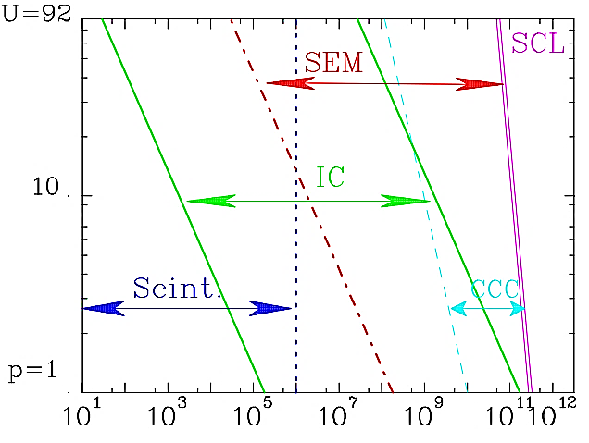
Comparison Current Measurement
Standard Beam current measurement techniques
  Current Transformers
    Measurement of beam’s magnetic field
    Not dependent on energy
    Detection threshold ~1µA
  Faraday cups
    Measurement of beams electric charges
    Destructive techniques
    For low energy only
    Current down to 10 pA with low bandwidth
  Particle detectors (Scintillators, IC, SEM)
    Detection of particles energy loss in matter
    Used for lower currents at higher energies
Nuclear Charge Z
Particles per second
Working ranges of the spill-intensity monitors
used for slow extraction at GSI
(SCL: space charge limit)
Courtesy of
F. Kurian
M. Schwickert | BI for FAIR | FC2WG-Meeting | 01 July 2015
<number>

Slide 19
DC Current Transformer (DCT)
Goal:
- determination of dc beam current
- typical meas. range: 10 µA – 20 A
Commercial ‚New Parametric‘ Current Transformer
(Bergoz Instrumentation)
M. Schwickert | BI for FAIR | FC2WG-Meeting | 01 July 2015
<number>

Slide 20
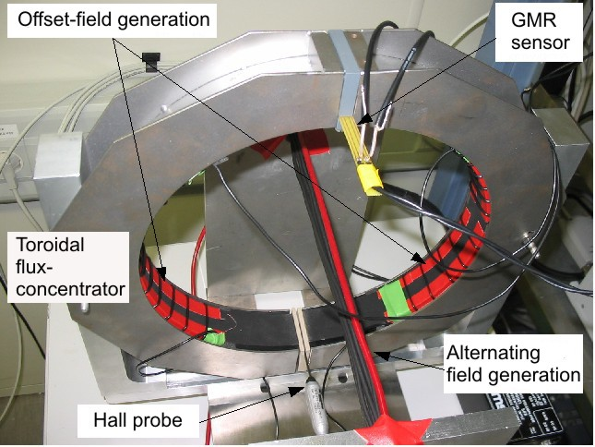
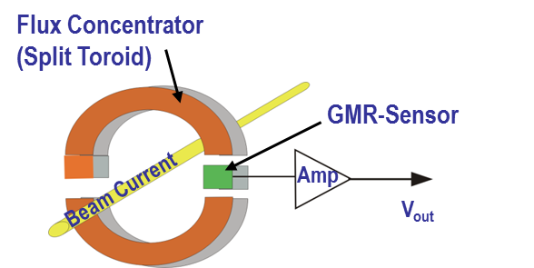
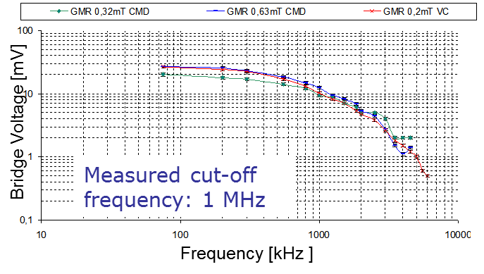
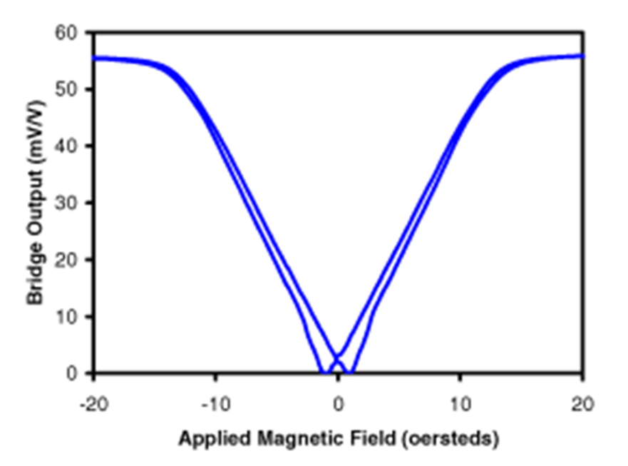
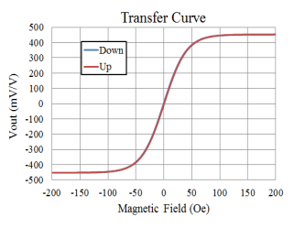
Novel DC Current Transformer (NDCCT)
Goals:
N-DCCT Test Setup
precise online measurement of accelerated and stored beams with large dynamic range of beam intensities and bunch frequencies
(eg. MHz →← standard DCCT)
desired meas. range: 100 µA – 150 A
desired input bandwidth: dc – several kHz
combination of 2 different transformers on single magnetic core
Basic Principle:
clip-on Ampere-meter design
split toroid to allow dismounting
before bake-out
soft-magnetic flux concentrator (amorph. VITROVAC®)
gap with induction of 80 µT @ 1 A beam current
sensitive GMR magnetic field sensor (resolution: 10⁻⁹ T/√Hz) or TMR sensor (resolution down to 10⁻¹¹ T/√Hz)
Frequency Response
(GMR + Pre-Amp)
Giant Magn. Res. vs. Tunneling Magn. Resist.:
M. Schwickert | BI for FAIR | FC2WG-Meeting | 01 July 2015
<number>

Slide 21
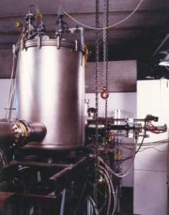
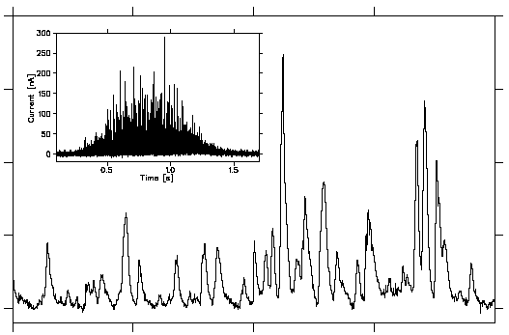
Cryogenic Current Comparator CCC (HEBT)
Role in HEBT Section
GSI prototype in 1997:
online current monitoring for slow extracted beams
beam current below threshold of regular transformers
desired meas. range: 0.5 nA – 100 µA
Measurement Principle
high-resolution detection of the beam's magnetic field
superconducting pick-up coil with ferromagnetic core
SQUID for sensitive detection
of coil magnetic field
collaboration: Univ. Jena, HI Jena
MPI-K Heidelberg, HIT Heidelberg, GSI
resolution improvement by optimal
selection of core material
7×10⁹ Ar¹¹⁺ at 300 MeV/u
within 1.2 s, readout 20 μs:
beam
current
200
150
Current [nA]
100
0.5
1.0
1.5
Time [s]
50
0
GSI prototype resolution:
8 nA (1 kHz readout) → 2×10⁹ U²⁸⁺/s
0.015
1.020
1.025
1.030
Time [s]
M. Schwickert | BI for FAIR | FC2WG-Meeting | 01 July 2015
<number>

Slide 22
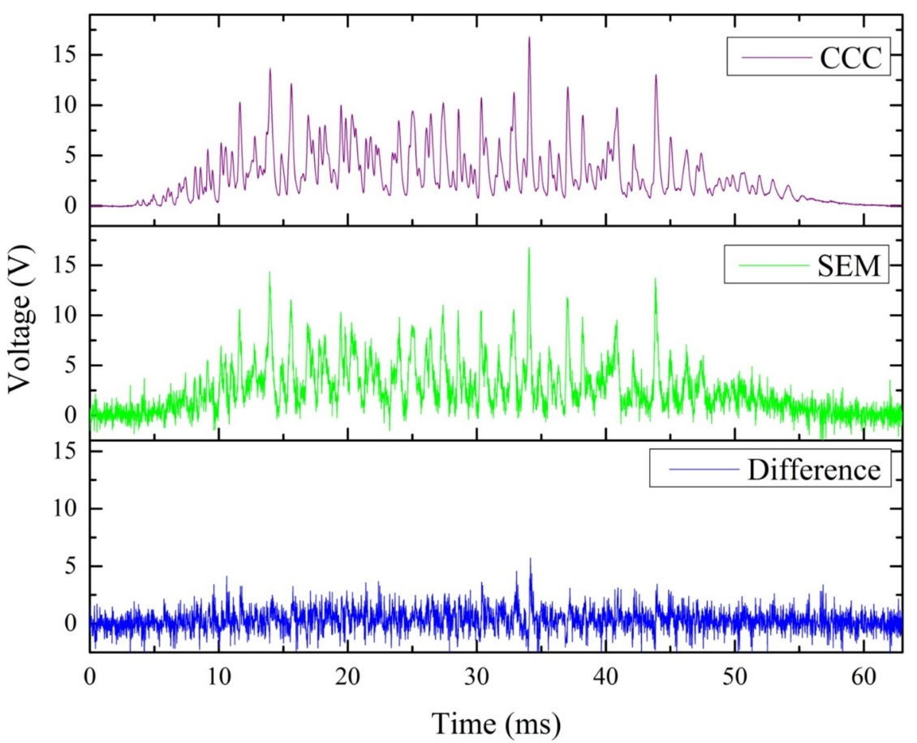
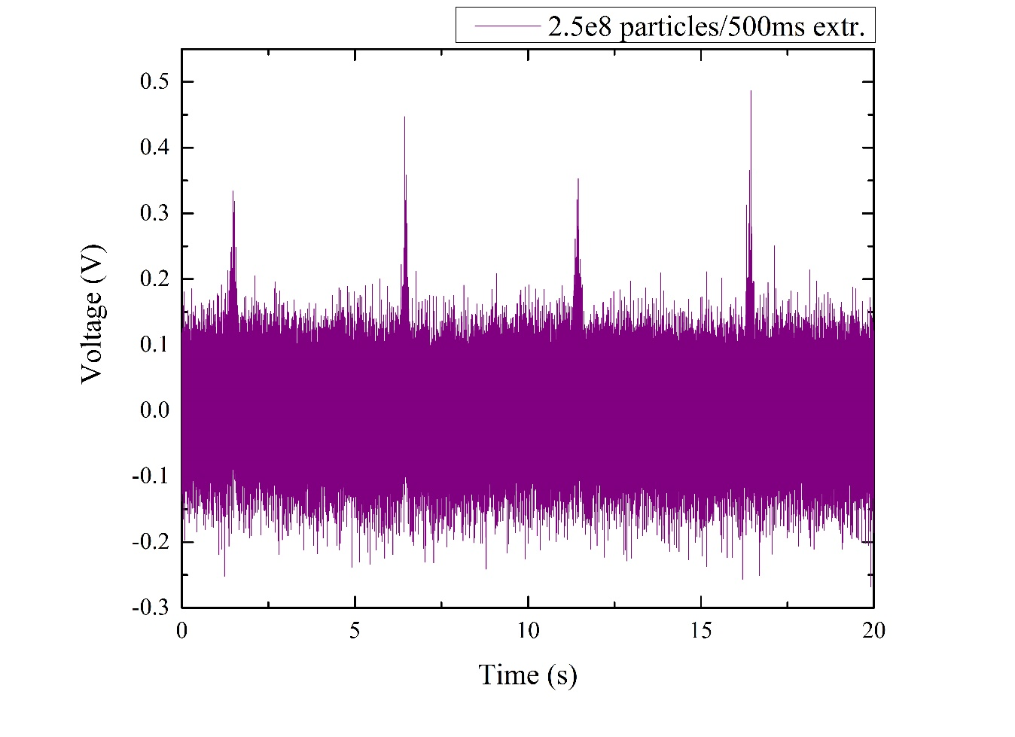
Comparison CCC / SEM, Spill Structure
Comparison of the spill structure measured by CCC and SEM for the 600 MeV particles of Ni²⁶⁺ extracted over 64 ms.
Both the SEM and CCC signals are filtered by low pass filter of 10 kHz
Spill structure with cut-off frequency of 10 KHz (given by the Anti-Alias filter)
Spill duration 350 ms, average current 2 nA signal to noise ratio SNR = 1.73 (4.78 dB)
Courtesy of
F. Kurian
M. Schwickert | BI for FAIR | FC2WG-Meeting | 01 July 2015
<number>

Slide 23
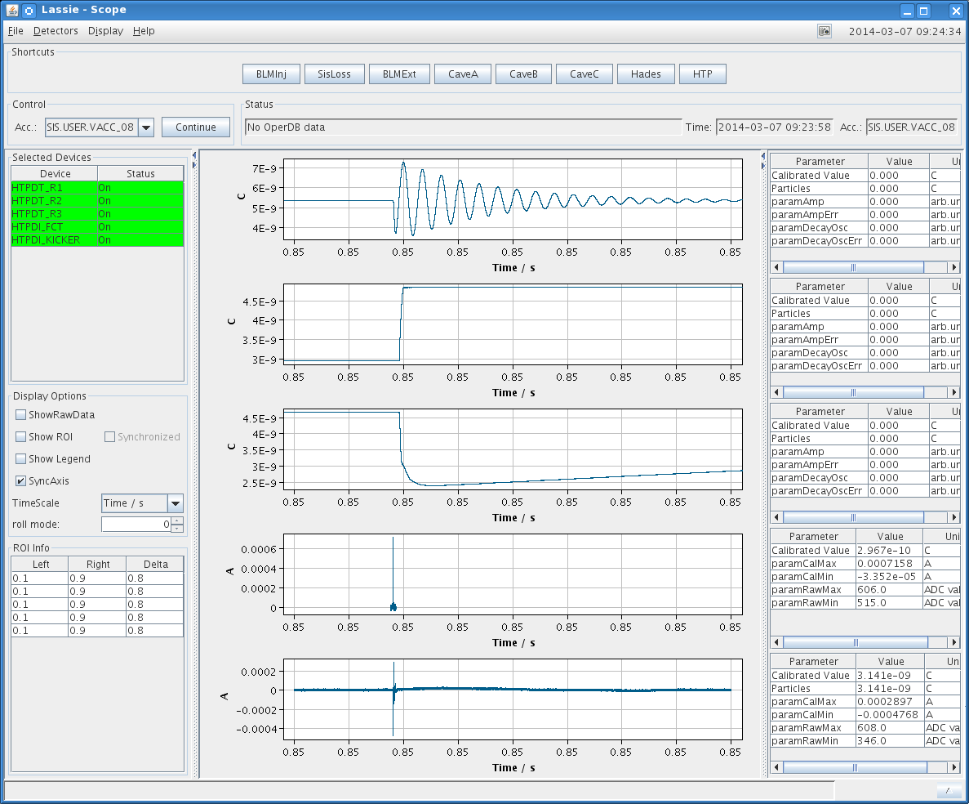
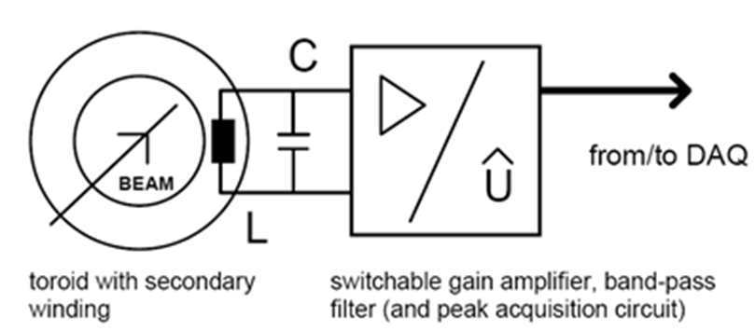
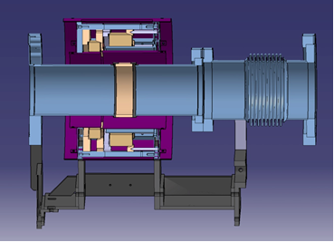
Resonant Transformer – RT
Goal:
- determination of total electric charge of a
bunched particle beam
- built-in calibration using precision pulser
- typical meas. range: 10 pC – 10 µC
(6E7 – 6E13 protons)
Contract situation:
DAQ: Slovenian InKind (signed)
RT signal
Technical Specs:
Number of elements | 36
Overall length | mm | 400
Horizontal aperture | mm | 220
Vertical aperture | mm | 220
Acceptable peak current | A | ≤ 150
Full scale | nC | 1...10000
Charge resolution |  | ≤ 1 % full scale
Built-in calibration |  | required
Prototype:
Mechanics, Electronics, detector, DAQ were designed, build and partly test with beam
Resonant
Transformer
µ-metall
shield
Fast Current
Transformer
Ceramic
Gap
M. Schwickert | BI for FAIR | FC2WG-Meeting | 01 July 2015
<number>

Slide 24
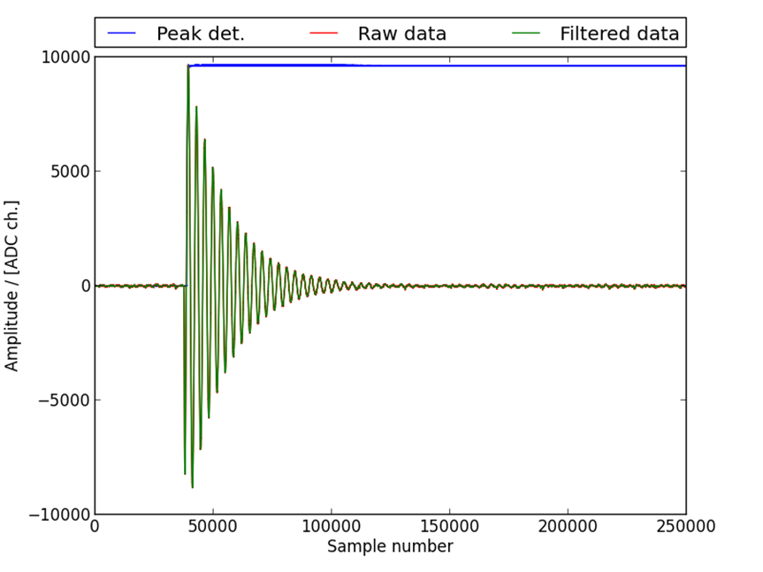
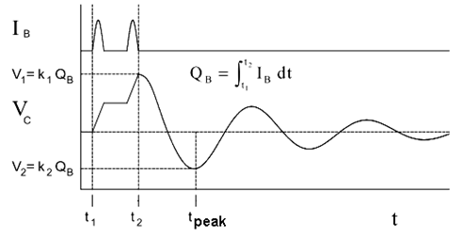
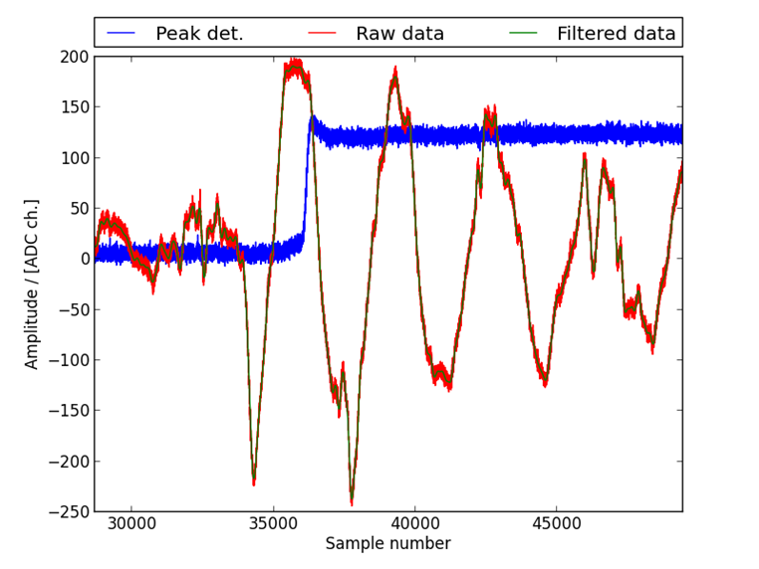
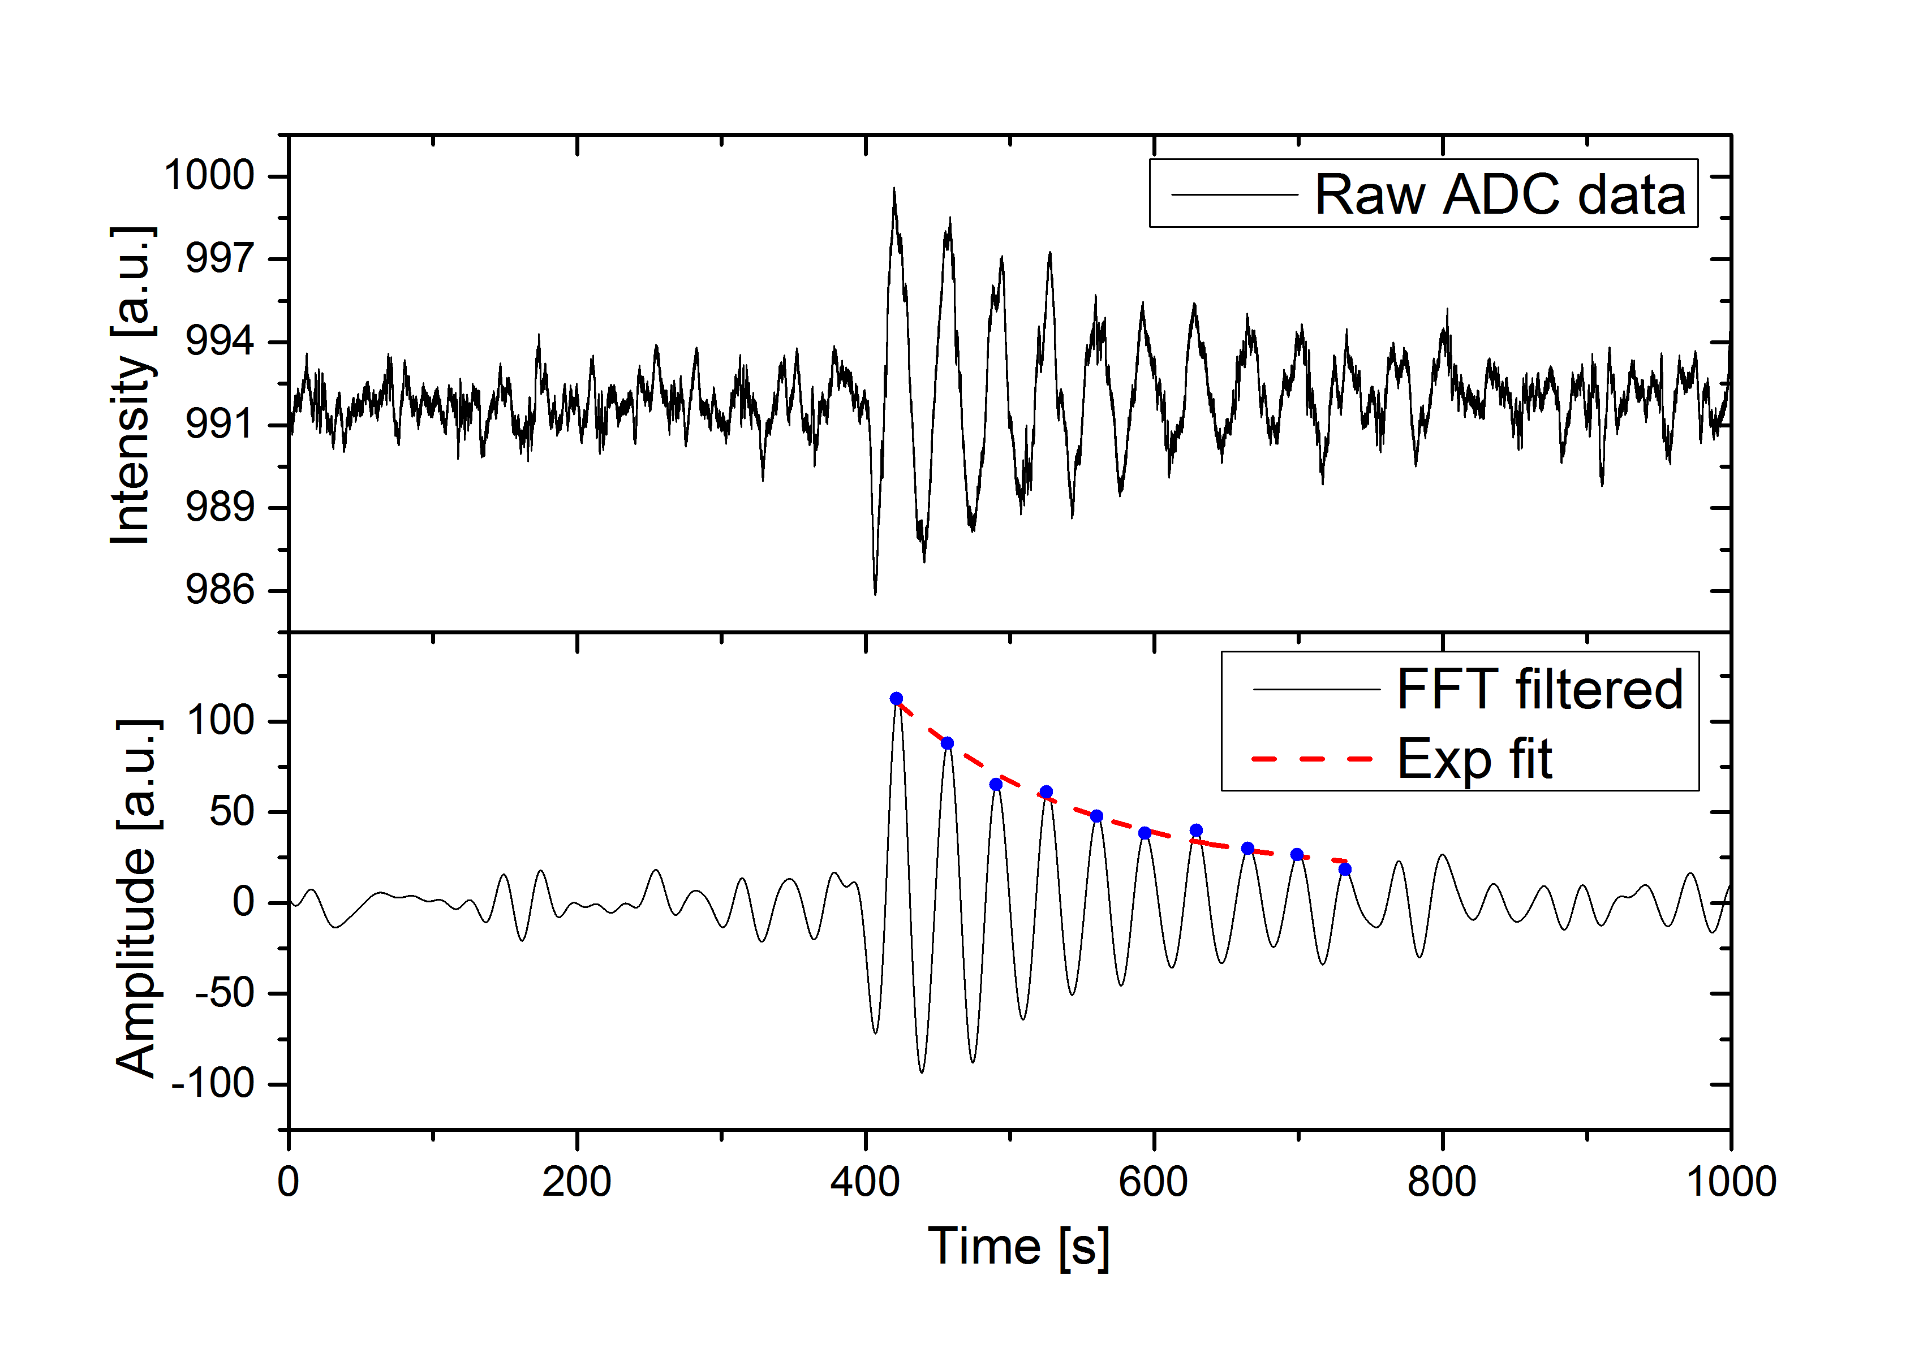
RT Improvement by Post-Processing
Basic Principle:
Post-Processing of
RT Oscillation Data:
bunch of charged particles excites damped oscillation in electronic circuit of the RT
oscillation amplitude is proportional to total charge of particle bunch
existing GSI RT: signal fed to peak detector
→ prone to noise at maximum position
large dynamic range: ~ 120 dB.
typical resolution: ~10 pC_{RMS} (6×10⁷ protons)
for high current operation resolution drops to 100 nC (6×10¹¹ protons)
→ insufficient e.g. for transmission control
1.5E9 proton ~ 0.25 FS
~0.24 nC~ 8000 ch. =OK!
idea: resonant frequency ω₀ and decay time constant λ, are fixed by hardware
omission of inexact peak detector
→ improved RT resolution by digitization of oscillation data, FFT filtering and envelope fit
Algorithm for bunch charge determination:
FFT filtering and offset correction
identification of maxima and minima until pre-set S/N value crossed
robust estimator of exponential decay curve
evaluation of amplitude ~ total pulse charge
Bunch Charge determination:
3E7 proton ~ 0.6% FS
~ 170 ch. ~ 5pC = limit!
1E6 Kr³³⁺ ions at 300 MeV/u
[from: “A High Stability Intensity Monitoring System”, M. A. Clarke-Gayther, RAL, Didcot (UK), presented on EPAC, Sitges (E) 1996]
Courtesy of A. Reiter
M. Schwickert | BI for FAIR | FC2WG-Meeting | 01 July 2015

Slide 25
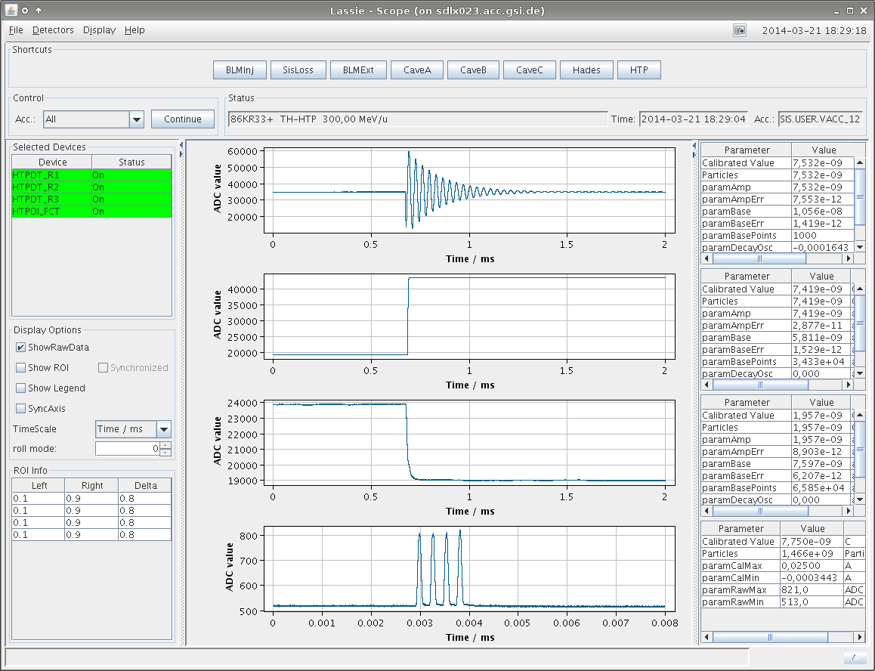
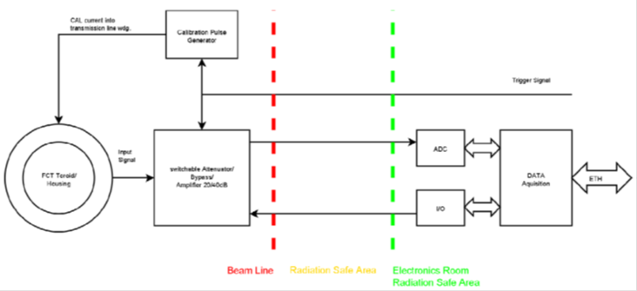
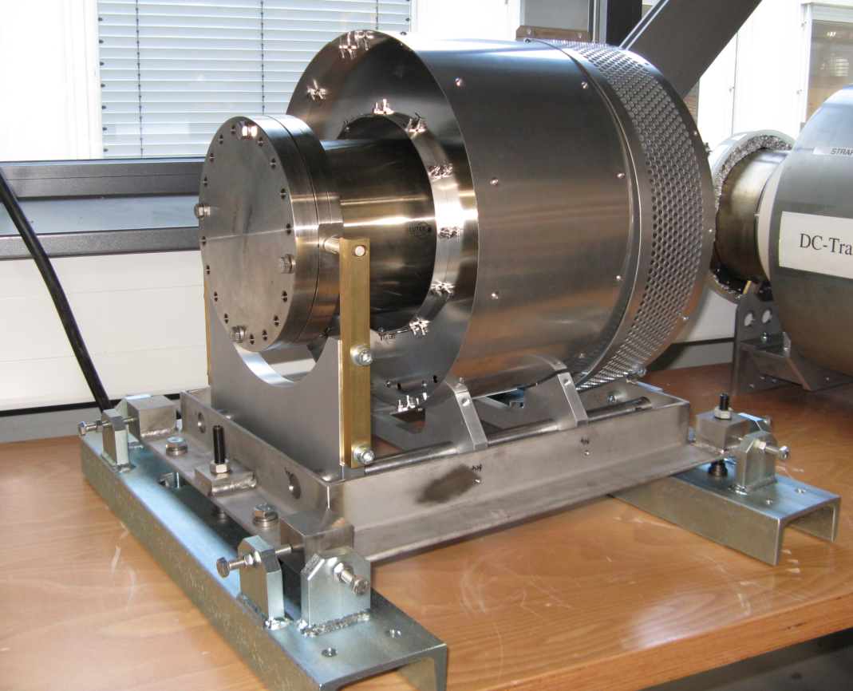
Fast Current Transformer – FCT
Goal:
- pulse current measurement
- typical meas. range: 30 µA – 150 A
- determination of the longitudinal bunch
structure for fast extracted beams
- built-in calibration using precision pulser
Contract situation:
DAQ: Slovenian InKind (signed)
FCT signal
Technical Specs:
Prototype:
Mechanics, Electronics, detector, DAQ were designed, build and partly test with beam
M. Schwickert | BI for FAIR | FC2WG-Meeting | 01 July 2015
<number>

Slide 26
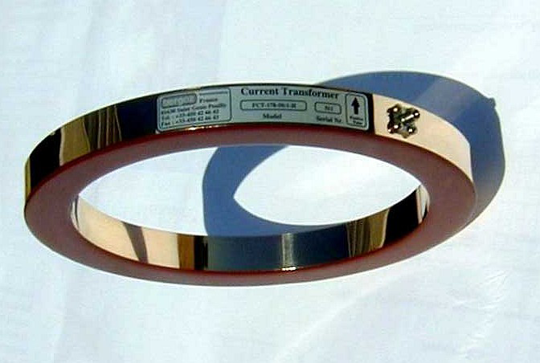
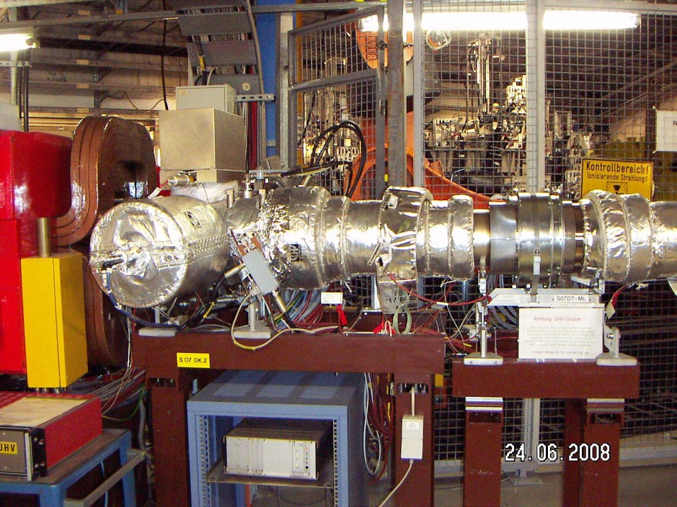
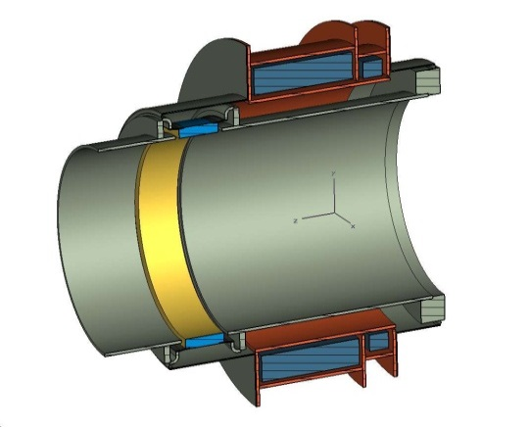
Ring FCT: Longitudinal Bunch Diagnostics
Commercial Fast Current Transformer
(Bergoz Instrumentation)
Fast Current Transformer (FCT) has extremely wide bandwidth
9 kHz < f < 650 MHz
50 Windings
resolution 1V/A in 50 Ohm
~30 μA for FCT with 500 MHz bandwidth
upper pulse current limit 1000 A
max. rms current 25 A
Exemplary realization at GSI
FCT installed in same shield as DCCT
DCCT
FCT signal was amplified by 20 dB (miteq AM-1422) and digitized a 500 Ms/s ADC via ~100m HQ coax cable
M. Schwickert | BI for FAIR | FC2WG-Meeting | 01 July 2015
<number>

Slide 27
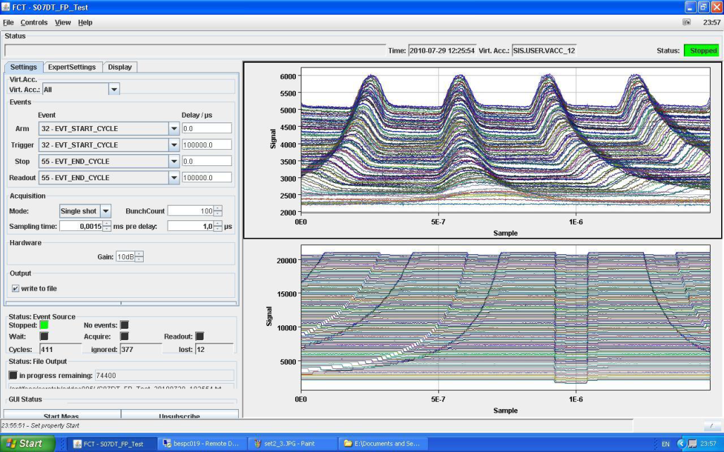
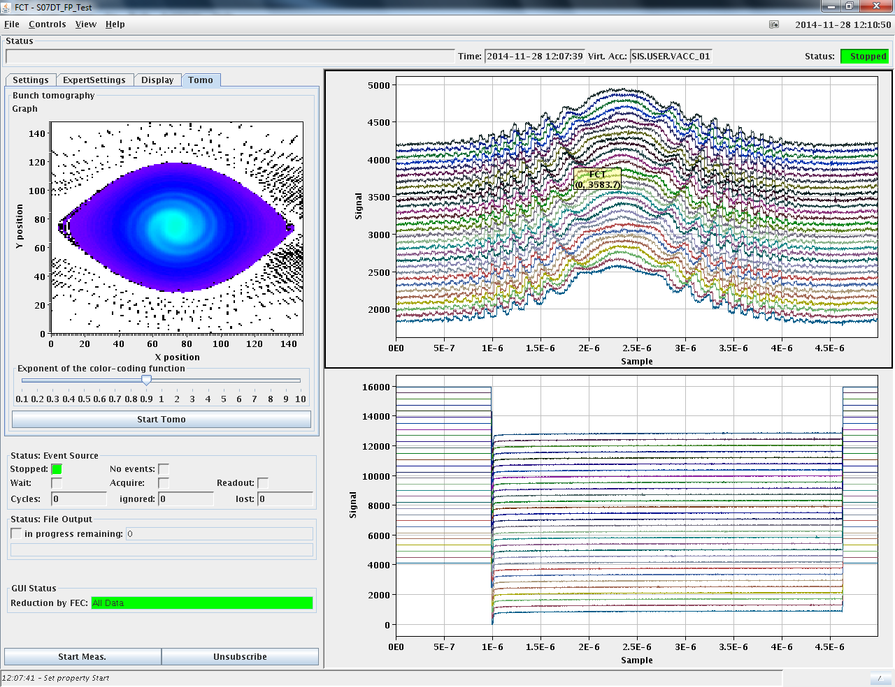
Ring FCT: DAQ Developments
Scheme for FCT DAQ
SIS timing
SIS timing
converter
single trigger
time gate
generator
digitized
RF signal
rate divider
trigger pulses
comparator
trigger
FCT detector
VME ADC
Measurement of 4 bunch acceleration in SIS 18
Development of online tomography
and tests with beam in SIS18
Main FCT application: bunch dynamics during RF manipulations. Example: SIS18 beam measurements using 8 bit LeCroy oscilloscope
Courtesy of:
O. Chorniy, H. Bräuning
RF capture at top energy
Fast compression at top energy
M. Schwickert | BI for FAIR | FC2WG-Meeting | 01 July 2015
<number>
Notes:
<number>

Slide 28
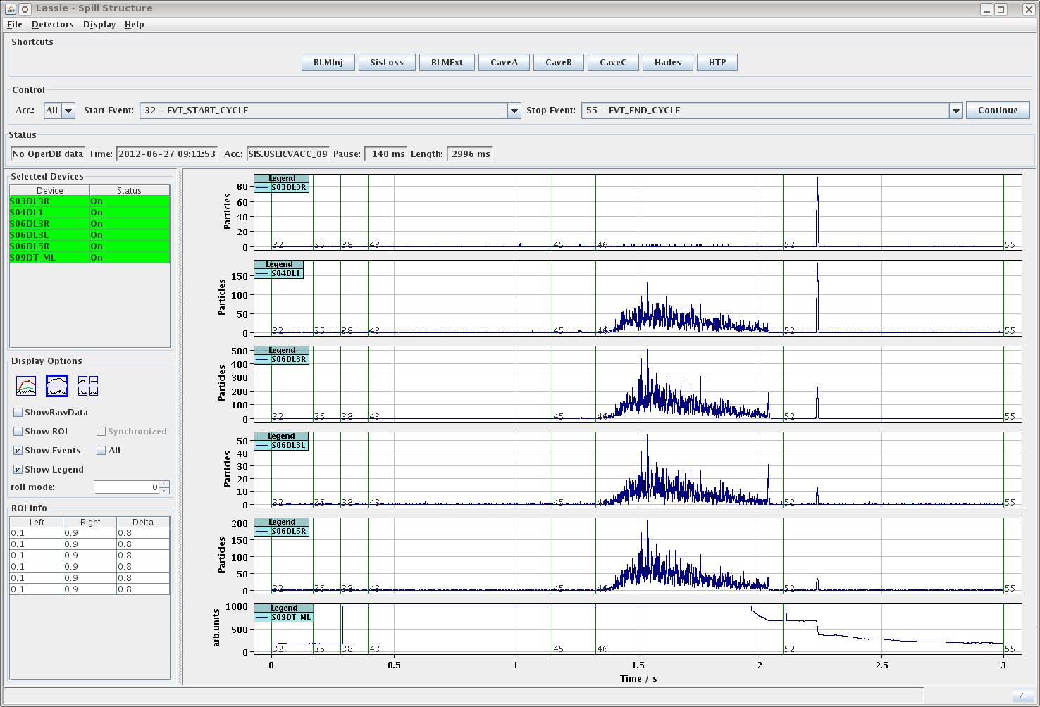
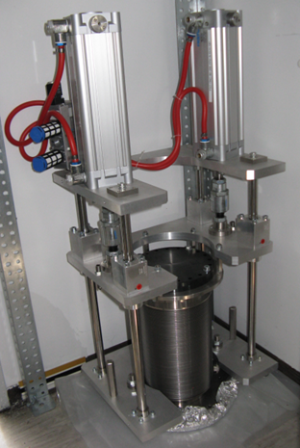
Particle Detector Combination – PDC
combination of plastic scintillator & secondary electron emission monitor
Goal:
- beam intensities and transmission
measurements for slow extracted beams
- typical measurement ranges:
scintillator: 100 – 1E6 particles/s
SEM: 1E5 – 1E11 particles/s
Contract situation:
DAQ: Slovenian InKind (signed)
scintillator signal
Prototype:
Mechanics, Electronics, detector, DAQ are currently to be finalized, build and partly tested with beam
Contract situation:
Detector, Mechanics, DAQ, HV, Long Cables,
Detector Gas: GSI InKind (signed)
Pneumatic Drive and Control: Slovenian InKind (signed)
Vacuum Chambers: India InKind (in preparation)
M. Schwickert | BI for FAIR | FC2WG-Meeting | 01 July 2015
<number>

Slide 29
PDC – Technical Specs
M. Schwickert | BI for FAIR | FC2WG-Meeting | 01 July 2015
<number>

Slide 30
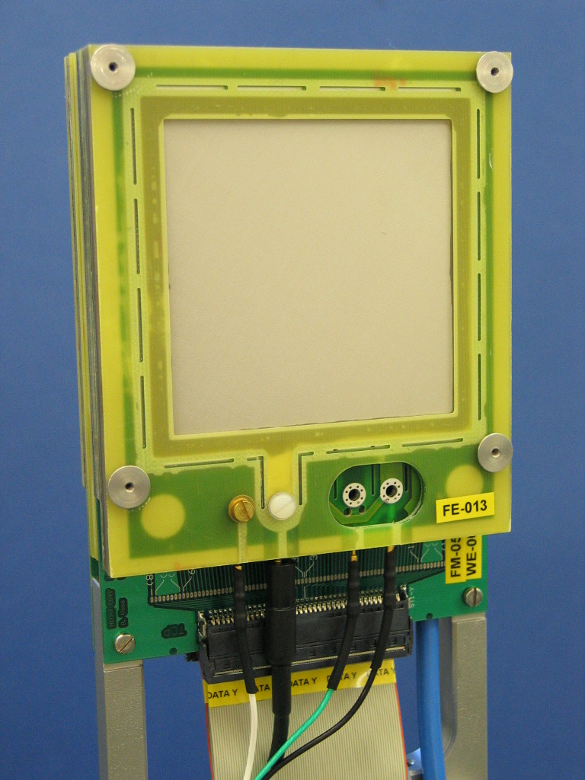
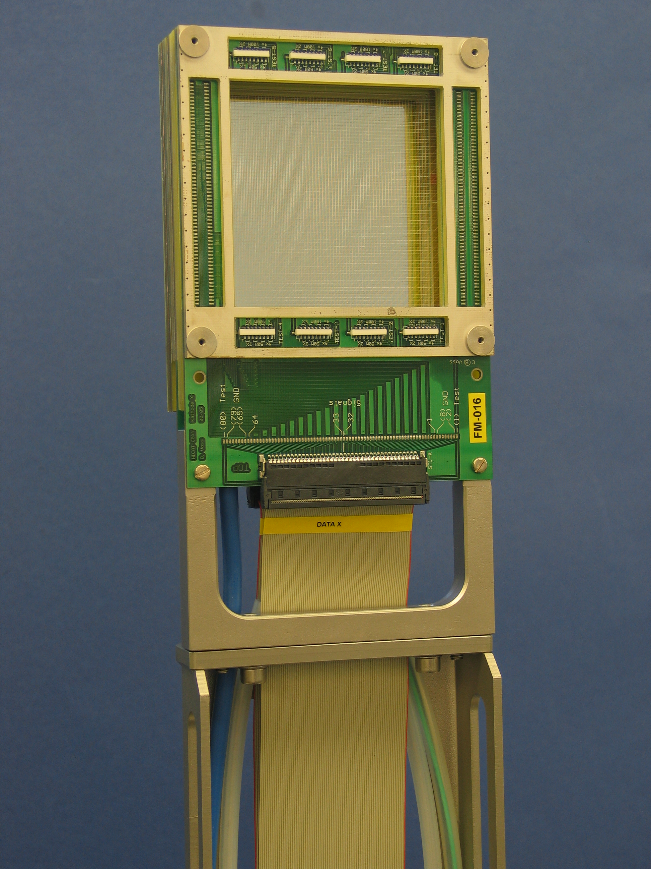
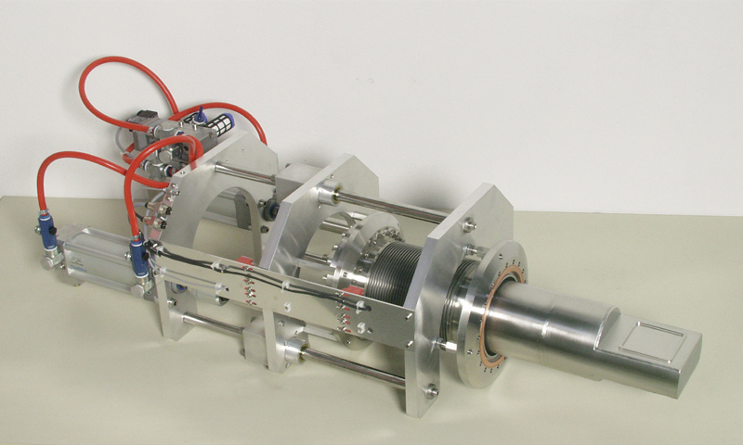
Ionization Chamber (MWPC/IC)
IC: Ionization
chamber
Goal for Ionization Chamber:
- beam intensities and transmission
measurement for slow extracted beams
- typical measurement range:
1E4 – 1E9 particles/s
MWPC: Multi-wire
proportional chamber
Beam intensity
Beam profile
Pneumatic drive with cylindrical housing for gas detectors
(foil window: 50µm stainless steel)
→ designed and manufactured by GSI Detector Lab (RBDL)
M. Schwickert | BI for FAIR | FC2WG-Meeting | 01 July 2015
<number>

Slide 31
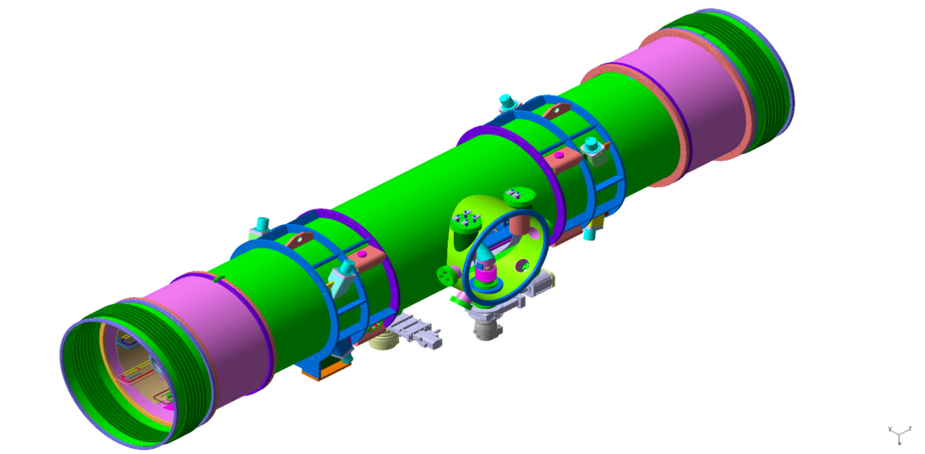
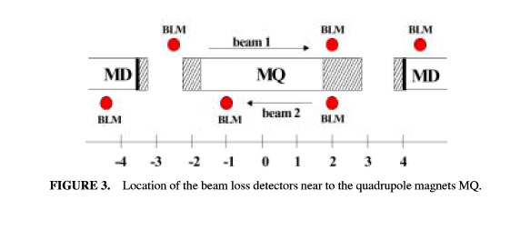
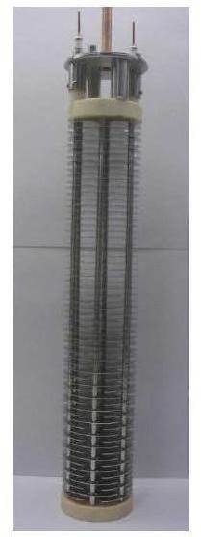
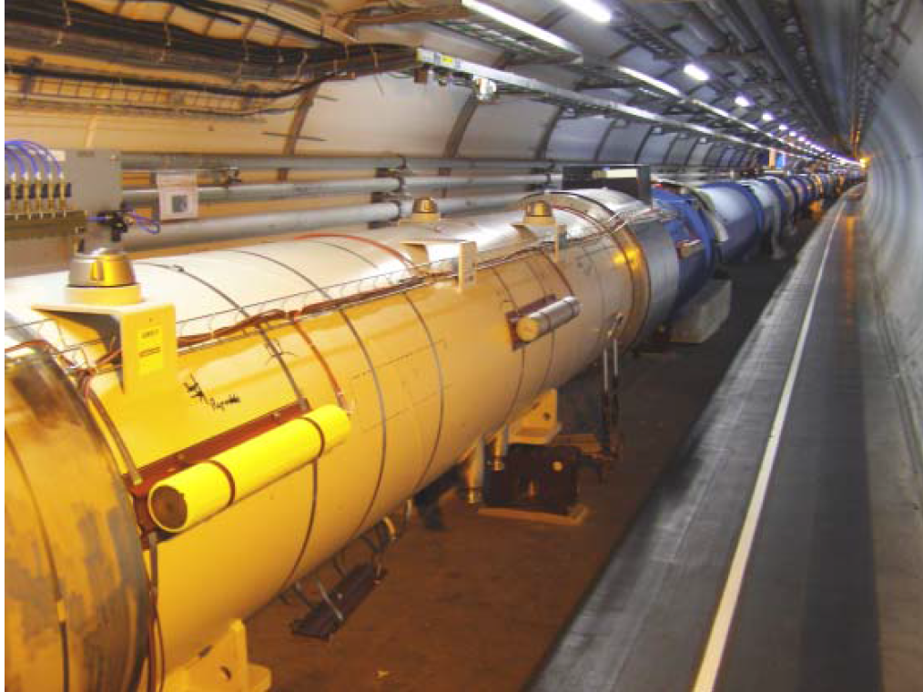
SIS100 Beam Loss Monitors (BLM)
Purchase of 200 pcs. CERN-type BLMs, ie. cylindrical ionization chambers (steel vessel, N₂ gas, 61 parallel plate Al electrodes)
Goal:
- detection of particle shower due to beam loss in SIS100
BLM are at the moment not foreseen for machine protection !!!
At LHC: 6 BLMs per Straight Short Section
2 BLMI per Quadrupole Doublet: 2*84 = 168
+ 32 for special locations like Injection, Extraction, etc. (200 in total).
FLUKA Simulation:
BLMI response on longitudinal impact of
p, e⁻, γ, n at 10 keV-1 TeV
Courtesy of
P. Kowina, V. Lavrik
M. Schwickert | BI for FAIR | FC2WG-Meeting | 01 July 2015
<number>

Slide 32
LASSIE
Large Analogue Signal and Scaling Information Environment
Courtesy of
T. Hoffmann
M. Schwickert | BI for FAIR | FC2WG-Meeting | 01 July 2015

Slide 33
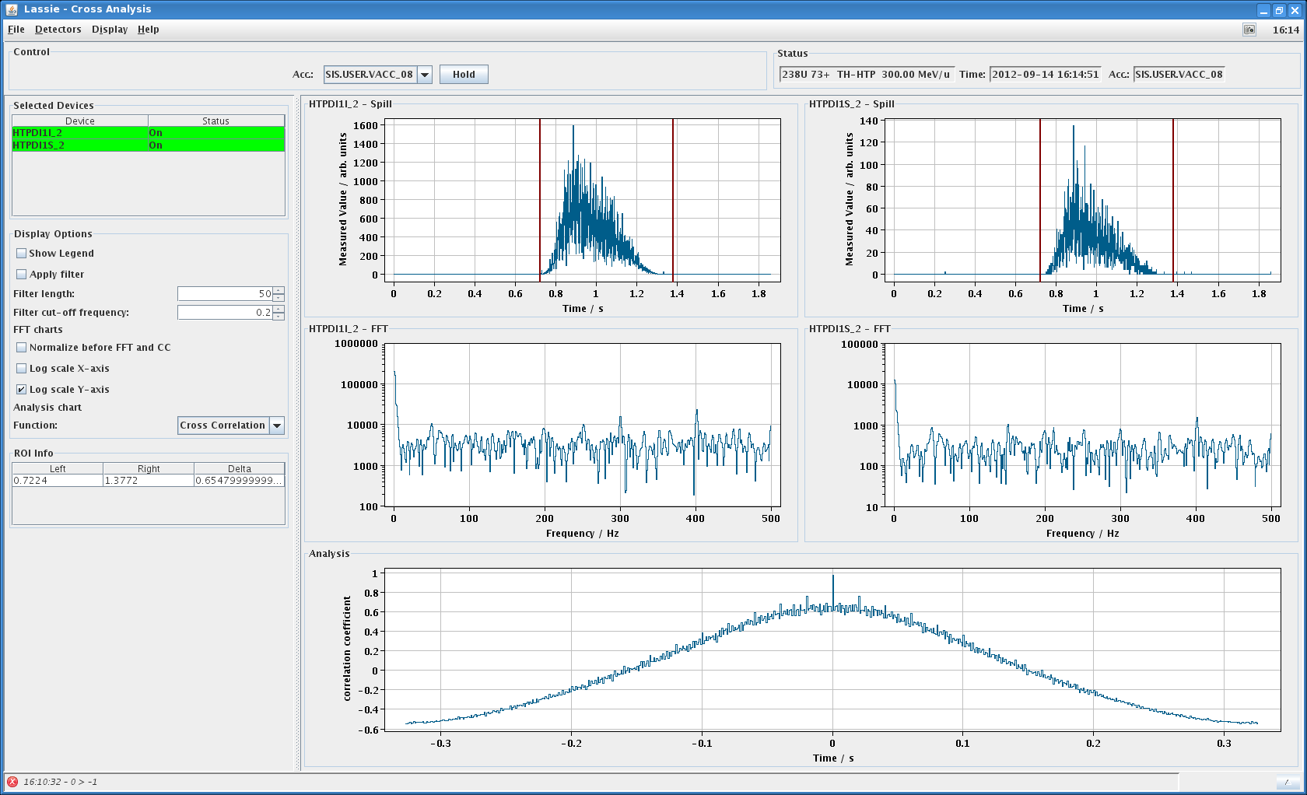
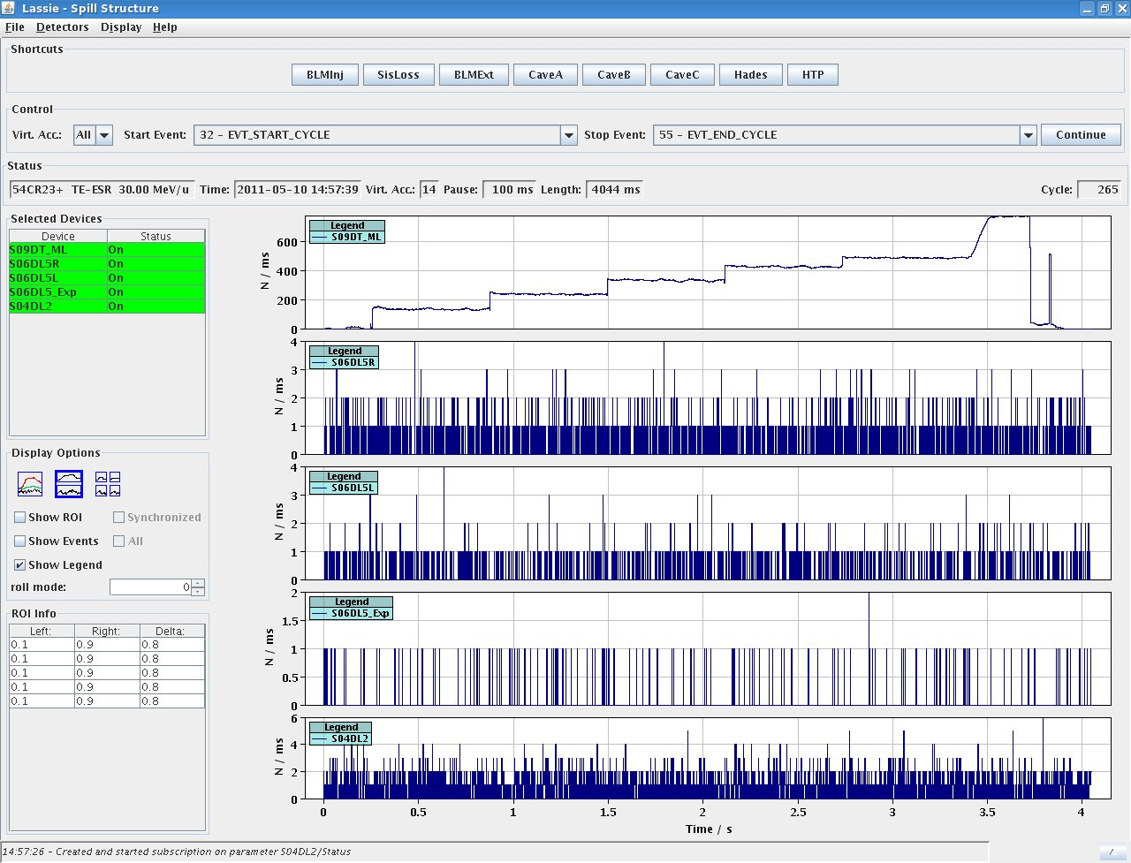
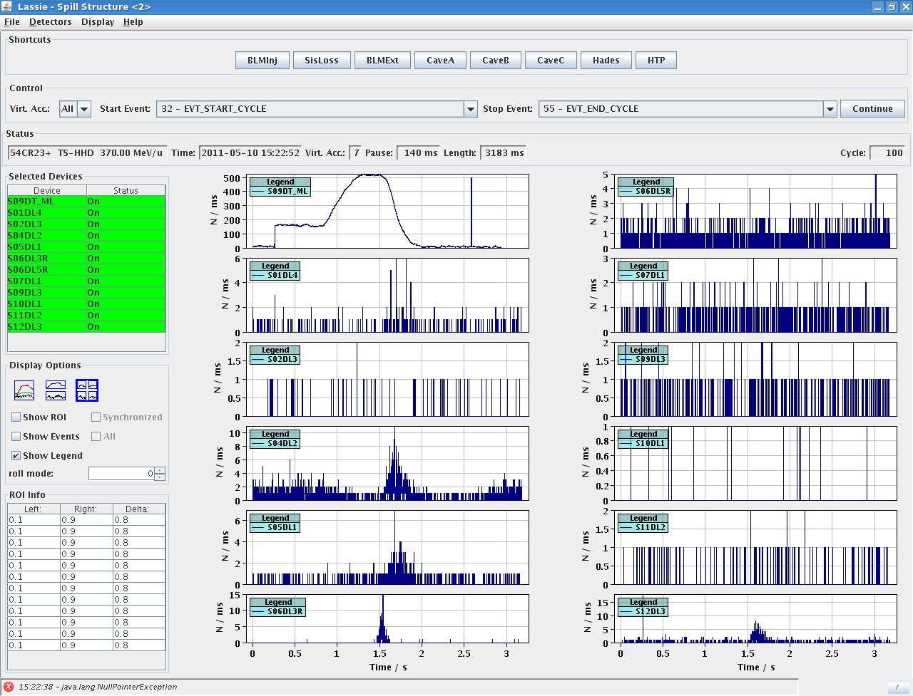
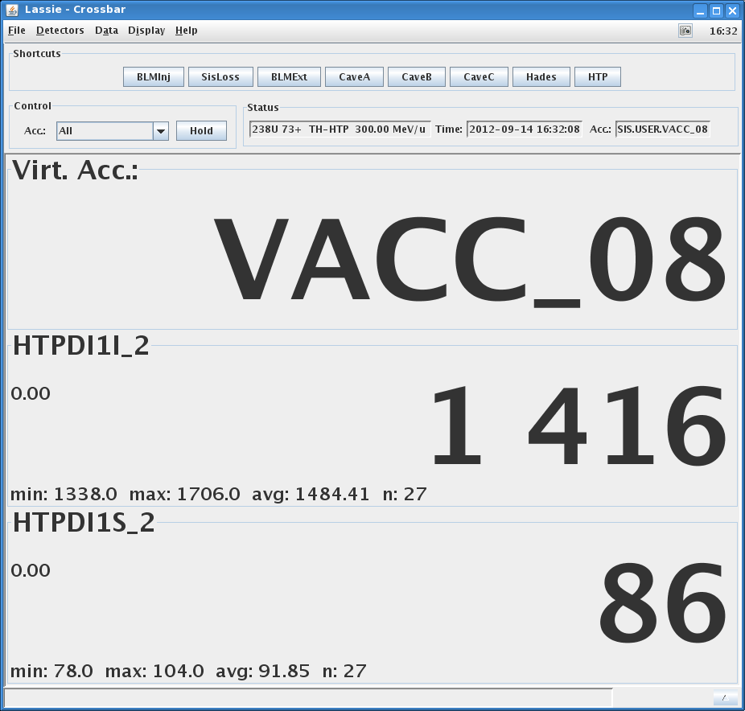
LASSIE Features
Precursor: ABLASS, i.e. conversion of analoge signals to frequencies counted in modular VME systems
LASSIE designed as distributed system, used at all FAIR accelerators in uTCA form factor
not restricted to BI systems, eg. rf signals, magnet ramps etc. using I/f- and U/f-conversion
acquisition, analysis and presentation
of time correlated signals
standard: sampling at 1 kHz, high resolution up to 1 MHz
LASSIE is fully FESA based, Java for analysis and display
data acquired over 1 accelerator cycle
LASA FESA class designed to handle 200+ channels
data storage of full acc cycles, min. 15 s with selectable sampling freq.
conversion to physical units (particles per second)
each scaler presented as separate device, integrated spill data over full acc cycle, or between 2 events
Courtesy of
T. Hoffmann
M. Schwickert | BI for FAIR | FC2WG-Meeting | 01 July 2015
<number>

Slide 34
BEAM
PROFILE
M. Schwickert | BI for FAIR | FC2WG-Meeting | 01 July 2015
<number>

Slide 35
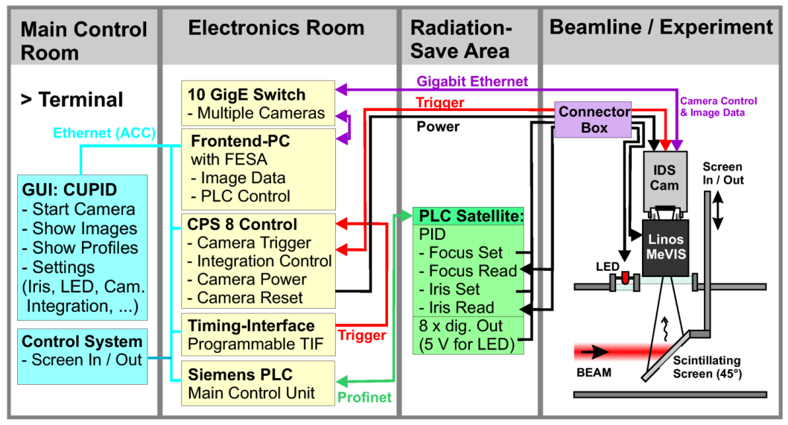
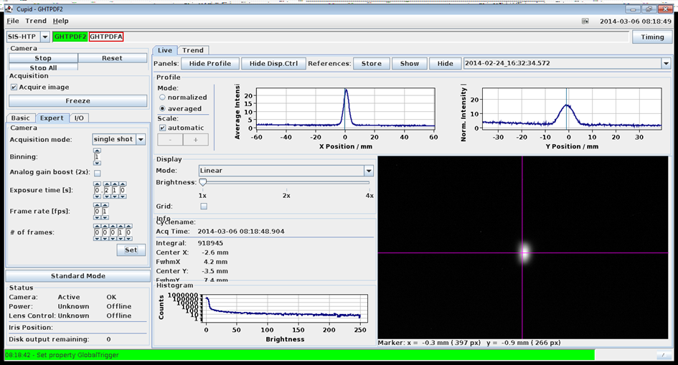
CUPID: Control Unit for Profile and Image Data
Courtesy of B. Walasek-Höhne
Fully FAIR-conformal System (FESA, IEPLC..)
Testbed: diagnostic upgrade of HTA (ESR→Cave A)
Radhard CID cam (‚Megarad‘, Thermofisher)
Framegrabber function available for analog cams
Features:
digital image acquisition (CMOS GigE camera)
pre-processing of optical data (rotation, stretching,
projections, intensity histogram)
performance: 15 fps (one client connected)
two network adapters (ACC, local GigE-network)
raw image data can be saved for offline analysis
PLC for control of lens focus, iris settings, LED for calibration
CUPID consists of 2 parts:
I) Data Acquis. and Control using FESA
  Front-end PC
  Processing of image data
  Slow-control using PLC
II) Java-based Graphical User Interface
  select and start cameras
  free-run or triggered mode
  adjust camera and iris settings
  display of processed image, hor. and vert. profile, Intensity histogram
M. Schwickert | BI for FAIR | FC2WG-Meeting | 01 July 2015
<number>

Slide 36
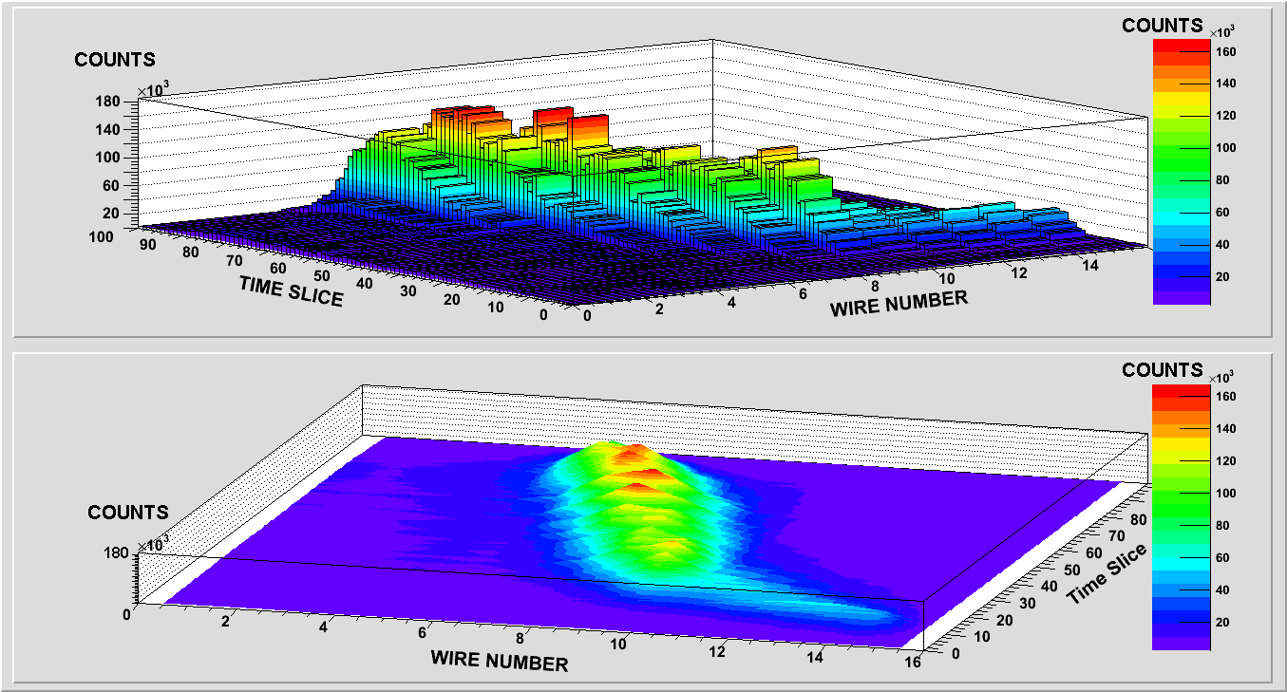
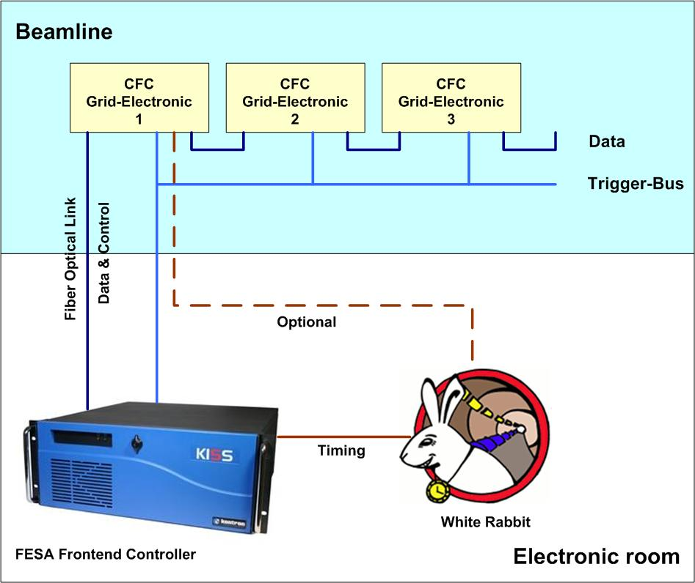
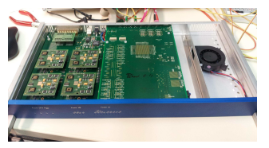
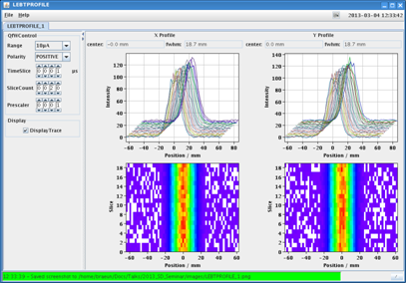
POLAND: PrOfiLe AcquisitioN Digitizer
CFC-Module (H. Flemming, Dep. CSEE)
32 input channels, units in daisy chain
ASIC with two ranges (0.24 / 2.4 pC/Pulse)
large dynamic range (300 fA – 180 µA)
output frequency up to 40 MHz
fully digital interface, FESA drivers available
Measurement of slow extraction using MWPC
2 s
MWPC 1
MWPC n
⁴⁰Ar¹⁸⁺ ion beam at 300 MeV/u
time-dependent beam profiles for 16 wires
spill duration: 1.8 s, time slices of 20 ms
for this measurement: beam mismatched on purpose
32 chan.
32 chan.
32 chan.
...up to 256 units
FESA-Graphical User Interface
X-Profiles
Y-Profiles
3rd (and final) prototype
M. Schwickert | BI for FAIR | FC2WG-Meeting | 01 July 2015
<number>

Slide 37
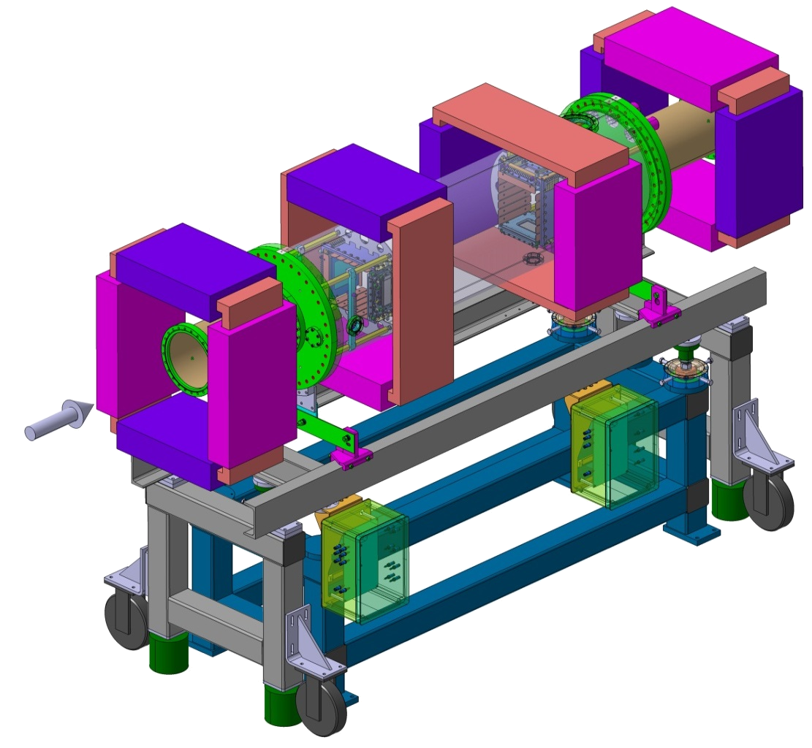

Ionization Profile Monitor (IPM) I/II
Magnetic field for electron guidance:
Corrector
Maximum image distortion:
5% of beam width ⇒ ΔB/B < 1 %
Challenges:
High B-field homogeneity of 1%
Clearance up to 500 mm
Correctors required to compensate
beam steering
Insertion length 2.5 m incl. correctors
read-out on ≈1 μs turn-by-turn scale
by multi-anode photo-multiplier
Vertical IPM
300mm
Horizontal IPM
Corrector
480mm
Insertion length 2.5 m
Compensation scheme:
Courtesy of
P. Kowina, T. Giacomini
Design by
G. de Villiers (iThemba Lab), T. Giacomini (GSI)
M. Schwickert | BI for FAIR | FC2WG-Meeting | 01 July 2015
<number>

Slide 38


IPM Prototype at SIS18
Goal:
IPM with high resolution
comparable to ESR installation
Hardware:
Phosphor & CCD readout
Insertion length 2.5 m in period S03
installation of magnets foreseen
Results: First commissioning at SIS18 done
Specs for SIS18: Approved
SIS100:
Will be almost 1:1 copy
of SIS18-IPM
IPM Profile Software
Profiles H & V
Beam Current
Beamwidth
Beamposition
BeamprofileIntegral
Images H & V
Courtesy of
P. Kowina, T. Giacomini
M. Schwickert | BI for FAIR | FC2WG-Meeting | 01 July 2015
<number>

Slide 39
BEAM
POSITION
M. Schwickert | BI for FAIR | FC2WG-Meeting | 01 July 2015
<number>

Slide 40


SIS100: Cryo Beam Position Monitor (BPM)
SIS100-QP-Doublet-Modul
( Typ 2.5)
Ceramic BPM Design
BPM
only upstream guard ring is fixed on main flange
remaining guard rings connected to chassis with RF fingers
Courtesy of
P. Kowina
M. Schwickert | BI for FAIR | FC2WG-Meeting | 01 July 2015
<number>

Slide 41

SIS100 BPM – Technical Specs
Goal:
precise beam position measurement
closed orbit control over whole cycle, also during rf manipulations (bunch compression, acceleration) and different extraction schemes
use of position data for closed orbit feedback
open: k-modulation possible?
Number of elements |  | 83
Overall length | mm | 400
Horizontal aperture | mm | 135
Vertical aperture | mm | 135
Pick-up bandwidth | MHz | 0.5-100
Resolution (single bunch) | mm | 0.5
Min. bunch current for given resolution | µA_{rms} | 20
Max. bunched beam current | A | 100
Output rate for closed-orbit feedback | kHz | 1
Requirements
all BPMs installed in cryo regions (quadrupole cryostats)
large dynamic range (1 µV< U_{plate}< 1 kV, mainly due to
variation in bunch length)
linear cut type BPM is preferred, because:
- good linearity even for transversally large beams,
or inhomogenious charge distributions,
eg. hollow beams
- bunch length >> BPM length
- rel. low bunch frequency: 0.5-2.7 MHz
mech. stability of ~50 µm required for 0.5 mm accuracy
good response in frequency range 0.1-100 MHz
all components suitable for XHV conditions (< 10⁻¹¹ mbar)
M. Schwickert | BI for FAIR | FC2WG-Meeting | 01 July 2015
<number>

Slide 42


BPM Prototype / Cryo Tests
Inner Ø: 135 mm
Length: 300 mm
Preparation of cryo tests inside lHe dewar
Courtesy of
P. Kowina
M. Schwickert | BI for FAIR | FC2WG-Meeting | 01 July 2015
<number>

Slide 43



SIS18-Prototype:
Tune, Orbit and POSition: TOPOS
Direct Baseband Digitization
SIS18 TOPOS - Prototype
digitization: 4 ADCs, 125 MSa/s, 14 bit
using LIBERA Hadron (I-Tech),
256 MB RAM, 1 Gbit interface
sample-synchronous processing in FPGA
development of FPGA algorithm for
noise reduction, integration-gate,
baseline reconstruction
bunch-by-bunch
position measurement
on synchrotron ramp:
Resolution,
1000 turns averaged
30 µm
7×10⁹ Ar¹⁸⁺
E: 11.4 → 300 MeV/u
rf: 0.85 → 3.6 MHz
Pos.-Polyn. Fit [µm]
Beam Position [mm]
Turns / 1000
12 BPMs, 12 LIBERAs, 2 concentrator servers
10 GBit Network, high data rate: 720 MB/s
DAQ software: FESA classes (Cosylab)
online tune evaluation (FFT)
Turns / 1000
M. Schwickert | BI for FAIR | FC2WG-Meeting | 01 July 2015
<number>

Slide 44



SIS100 BPM: DAQ Design
Hardware Layout:
24 LIBERA Hadron Platform B stations (Instrumentation Technologies)
84 BPM modules
0.04 – 55 MHz RF front end bandwidth
250 MSa/s sampling frequency
16 bit ADC, 12 effective bits
Libera Hadron Platform B
(courtesy Instrumentation Technologies, www. i-tech.si)
4 Principal Modes of Operation:
Bunch-by-bunch mode
- closed orbit, X,Y vs. BPM
- Trending X,Y vs. time/bunch
- Trending mean over n BPMs
- Sum of amplitudes vs. time/bunch
- Tune: FFT of BbB data
Raw ADC data mode
- subset of 14 BPMs vs. time/samples
Zero ADC calibration mode
- R-,L-,U-,D-offsets for all BPMs
Position calibration mode
- X_{off}, Y_{off} for all BPMs
M. Schwickert | BI for FAIR | FC2WG-Meeting | 01 July 2015
<number>

Slide 45
SIS100 Closed Orbit Feedback
Concept:
System Schematic
Libera Hadron measure beam position
export in real-time at a fixed rate 10 kHz
Position data concentrator collects data from all BPMs and builds the actual orbit
Interconnection of Libera stations by
GDX module with Libera Grouping protocol
Control logic/Data Processing Unit (DPU) calculates magnet correction signal based on desired and actual orbit, algorithm resides in the GDX modules
Power converter interface sends correction signal to the steerer magnets (USI protocol, RS-485).
Timing Diagram
M. Schwickert | BI for FAIR | FC2WG-Meeting | 01 July 2015
<number>

Slide 46
Tune Measurement: BBQ & TOPOS
BBQ: Base-Band Tune Measurement
Tune Measurement with TOPOS
Courtesy of R. Singh
M. Schwickert | BI for FAIR | FC2WG-Meeting | 01 July 2015
<number>

Slide 47
Summary
BI-Mission to provide all relevant beam parameters...
...up to FEC level
Infrastructure: FESA, PROFINET, Siemens PLC, MBox, REMBRANDT...
In-Kind Contributions by Slovenia, Russia, India, France
Integrated BI systems:
LASSIE (all particle counters & more),
CUPID (scintillating screens),
POLAND (SEM-grids, multi-wire proportional chambers),
TOPOS (beam position monitors, tune measurement)
Beam Intensity Measurement
(DC Current Transformer, Novel DC Current Transformer, Fast Current Transformer, Resonant Transformer, Cryogenic Current Comparator, Scintillating Counter, Secondary Electron Monitor, Ionization Chamber)
Beam Profile Measurement
(Scintillating Screen, Multi-Wire Proportional Chamber)
Position Measurement (Beam Position Monitors, Closed-Orbit Feedback)
Tune Measurement by noise excitation and Base-Band Tune System (BBQ)
M. Schwickert | BI for FAIR | FC2WG-Meeting | 01 July 2015
<number>

Slide 48

Thank you!
Special thanks to the fantastic BI-team !!
Thank you for your attention!
M. Schwickert | BI for FAIR | FC2WG-Meeting | 01 July 2015

Slide 49
Open Questions BI
BI Detectors, Devices, Infrastructure and FEC SW are clearly defined, ready for production and to great deal ready for tests (eg. Cryring),
superordinate/integrated systems (eg. Transmission Monitoring, Machine Protection...) are NOT !
No clear procedure for development of integrated systems yet! (who?, what?, how?)
User requirements are missing to large extent! (For the moment we try to supply maximum set of parameters to be prepared.)
Larger discussion / agreement on infrastructure topics (PROFINET, database, safety issues) is required.
Open issues:
  Definition, technical layout, manufacturing plan for interlock system
  (many ILKs from BI devices)
  Definition Definition, technical layout, manufacturing plan for machine protection system
  (many BI devices are sources/drains for machine protection, eg. BLMs, Stopper....)
  Commissioning Concept for each machine (general strategy, required measurements....)

Slide 50
Spare Slides
<number>

Slide 51

Fast ADC Board (FCT...)
Example for commercially available ADC board:

Slide 52

Slow ADC (DCT, N-DCCT, CCC,....)
Example for commercially available ADC board:

Slide 53


Multi-Channel Scaler Module
Example for commercially available scaler module (uTCA variant now available):

Slide 54


Slide 55


Slide 56



Cryogenic Current Comparator (CCC)
He gas exhaust
Temperature /Pressure/ LHe level Readout
Amplifier
Oscilloscope & FFT
Thermal insulation + Radiation shield
LHe Dewar
DC SQUID
SQUID control +
Readout
beam
50cm
GM refrigerator
M. Schwickert | BI for FAIR | FC2WG-Meeting | 01 July 2015
<number>

Slide 57


CCC Prototype Tests at HTP
CCC test setup at HTP
CCC
M. Schwickert | BI for FAIR | FC2WG-Meeting | 01 July 2015
<number>

Slide 58

CRYRING@ESR: Beam Instrumentation
Planning
Hardware & DAQ layout fixed
Infrastructure in preparation (cable lists, container, racks, ProfiNet)
Integration into ACS to be discussed soon (GSI & FAIR timing, LSA, Interlock)
MSL Hardware Tests
All HW was tested,
→ no damage on critical components!
IPMs: OK, final test with alpha source and new
FESA DAQ in preparation
PCT: all HW OK, “cross talk” due to sextupole magnet
measured
BPMs: New pre-amplifier design developed and tested
Hardware development
Pickups (Linac): GSI HW available
SCR: SPS satellite & Timing unit CPS8 ready and tested
Power supplies for IPM, ICT ready
FC: Connector box under construction
SW development
FESA classes for FC, SCR, Switching Matrix, High Voltage exist
Basic FESA class for IPM exists
Infrastructure monitoring project Rembrandt
ESR inj.
Shorter, more compact RFQ beam line with „new“ debuncher
Sector 10
Sector 12
Sector 1
Sector 7
Sector 2
Sector 3
No. <number>
<number>

Slide 59
DS Beam Transmission Monitor System

